Slide 1

People’s Democratic Republic of Algeria
National Polytechnic School of Oran – Maurice Audin
Department of Computer Systems Engineering
OSI & TCP/IP Model
Dr.BOUMEDJOUT AMAL
Email: amal.boumedjout@enp-oran.dz

Slide 2
Course Objective
  By the end of the course, students will be able to:
  Understand the purpose and structure of the OSI model and the TCP/IP model
  Identify the layers of each model and explain their main functions
  Explain how data is encapsulated and transmitted across network layers
  Understand the role of key network protocols (IP, TCP, UDP, ICMP)
  Compare the OSI model with the TCP/IP model
  Understand how packet routing and reliable transmission are achieved
  Use basic network tools, such as ping, to test connectivity

Slide 3
OSI Model / TCP/IP Model
The OSI (Open Systems Interconnection) reference model, introduced in 1984, was created by the ISO as a model to describe network communication. It sets common rules that make it easier for network technologies from different companies around the world to work together.

Slide 4
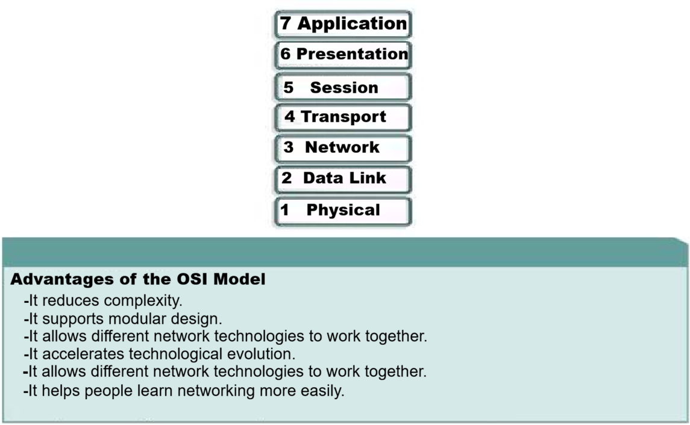
The OSI Model

Slide 5
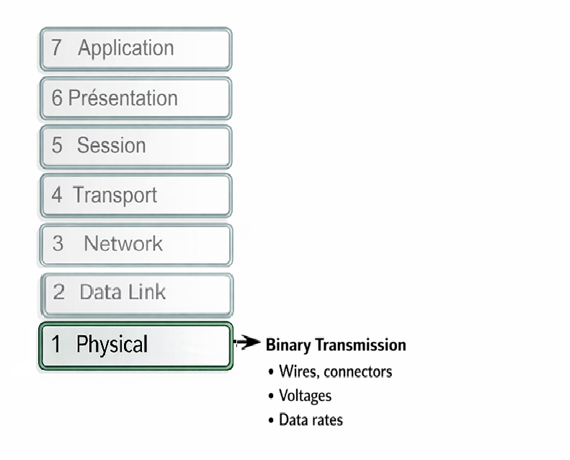
The OSI Model

Slide 6
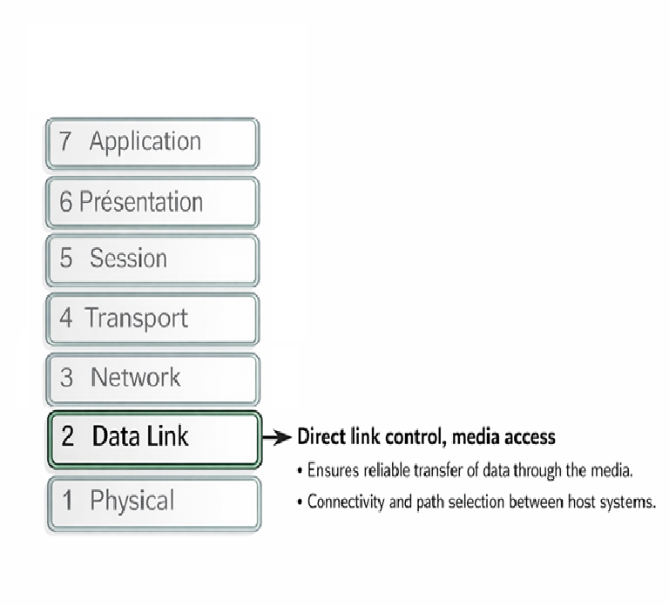
The OSI Model

Slide 7
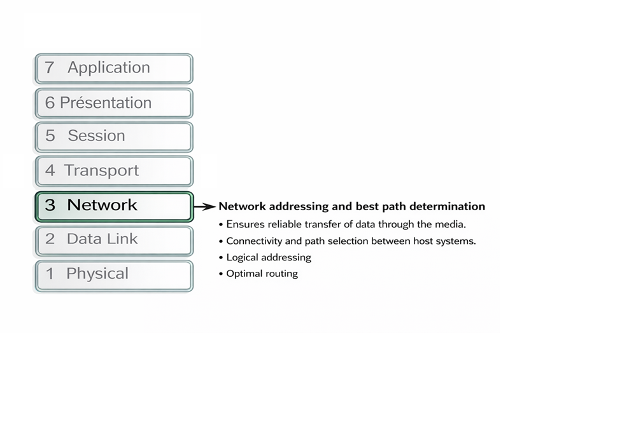
The OSI Model

Slide 8
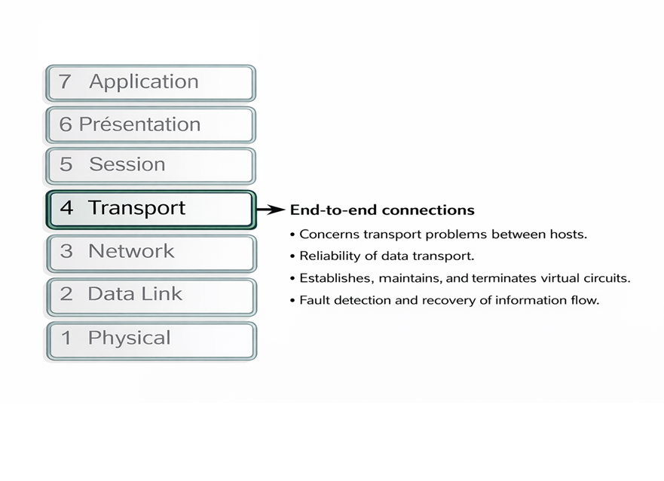
The OSI Model

Slide 9
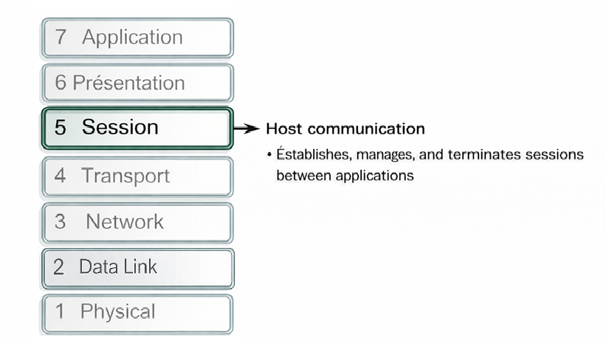
The OSI Model

Slide 10
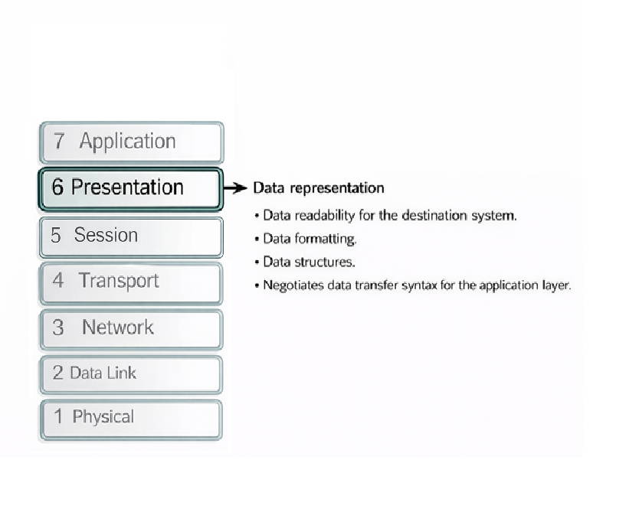
The OSI Model

Slide 11
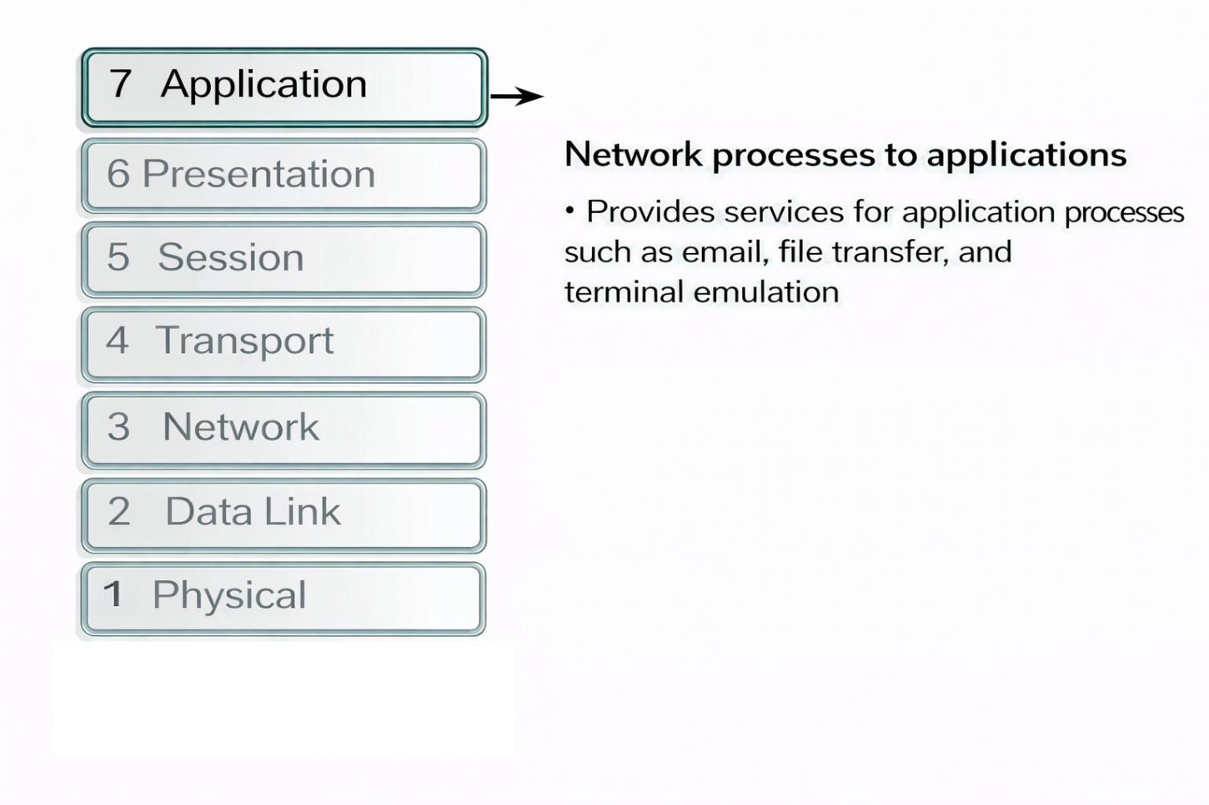
The OSI Model

Slide 12
switchs
Application
Presentation
Session
Transport
Network
Data Link
Physical
Data
Data
Data
Segment1
Segment2
Segment3
N°Segment
Packet
(@IPS, @IPDest)
Frame
(@Mac Source, @MacDest, Control (CRC))
110001100

Slide 13
TCP/IP Model
The TCP/IP reference model was developed by the U.S. Department of Defense to create a network that could continue to operate in any situation, even in the event of a nuclear attack. In an environment using different communication media like copper wiring, microwave transmission, optical fiber, and satellite links, the goal was to ensure that data packets would always reach their destination. This highly challenging requirement led to the creation of the TCP/IP model.
TCP/IP was developed as an open standard.

Slide 14
TCP/IP Model
The TCP/IP model includes the following four layers:
        Application layer
        Transport layer
        Internet layer
        Network access layer

Slide 15
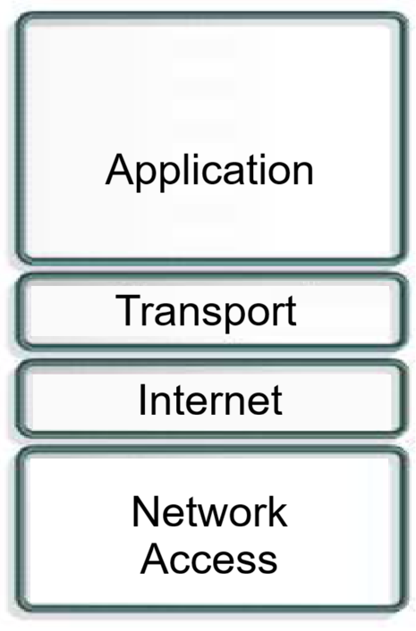
TCP/IP Model
Although certain layers in the TCP/IP model share the same names as those in the OSI model, they are not exactly the same. In particular, the application layer plays a different role in each model.

Slide 16
TCP/IP Model
The transport layer focuses on service quality, such as making sure data is delivered correctly and at the right pace. One of its protocols, TCP (Transmission Control Protocol), makes it possible to build stable network communications with few transmission errors.

Slide 17
TCP/IP Model
The TCP protocol is connection-oriented. It maintains a dialogue between the source computer and the destination computer while it prepares the application layer information into units called segments. A connection-oriented protocol does not mean that there is a circuit between the communicating computers.

Slide 18
TCP/IP Model
The Internet layer is designed to divide TCP segments into packets and forwarding them across interconnected networks. These packets arrive at the destination network regardless of the route taken. The protocol governing this layer is the Internet Protocol (IP). The best path determination and packet switching are carried out at this layer.

Slide 19
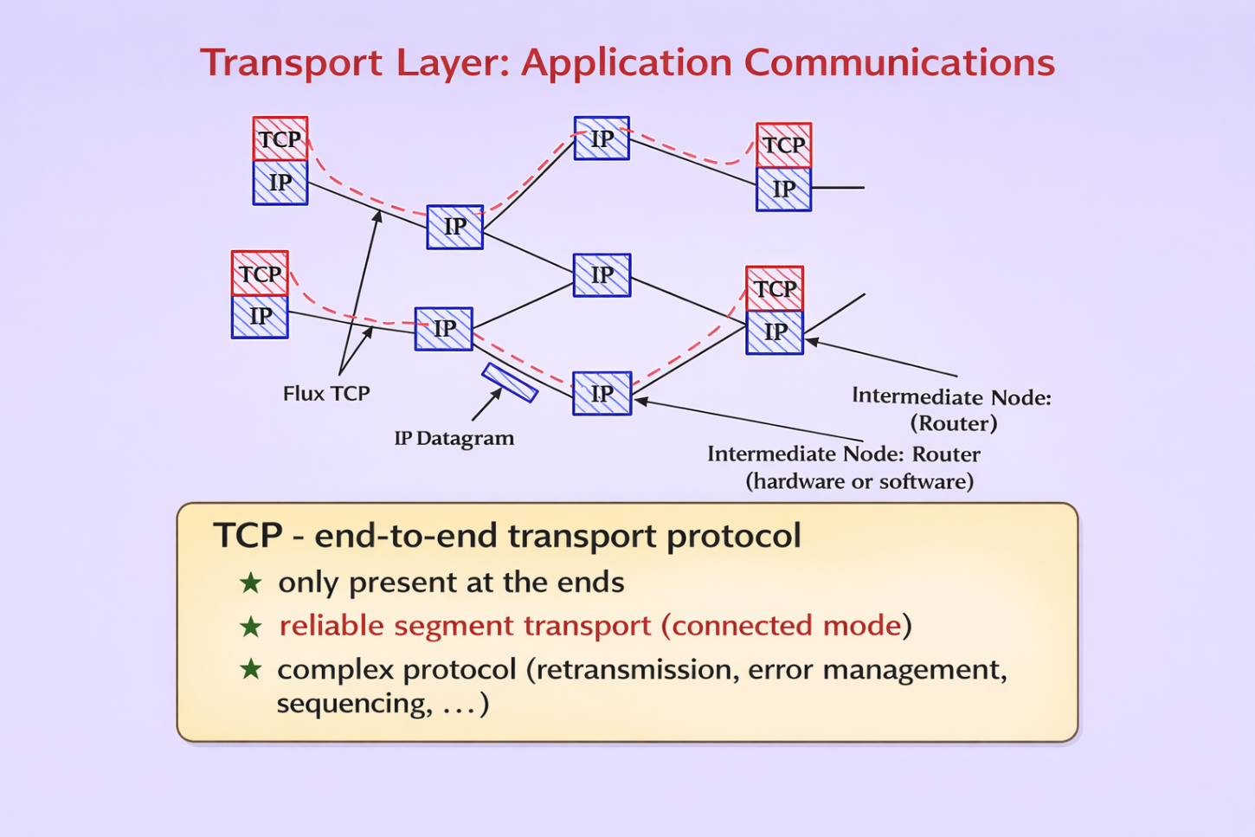
TCP/IP Model

Slide 20
TCP/IP Model
What is the relationship between IP and TCP?
Each protocol serves a different purpose: IP handles packet routing, while TCP provides reliable data delivery.

Slide 21
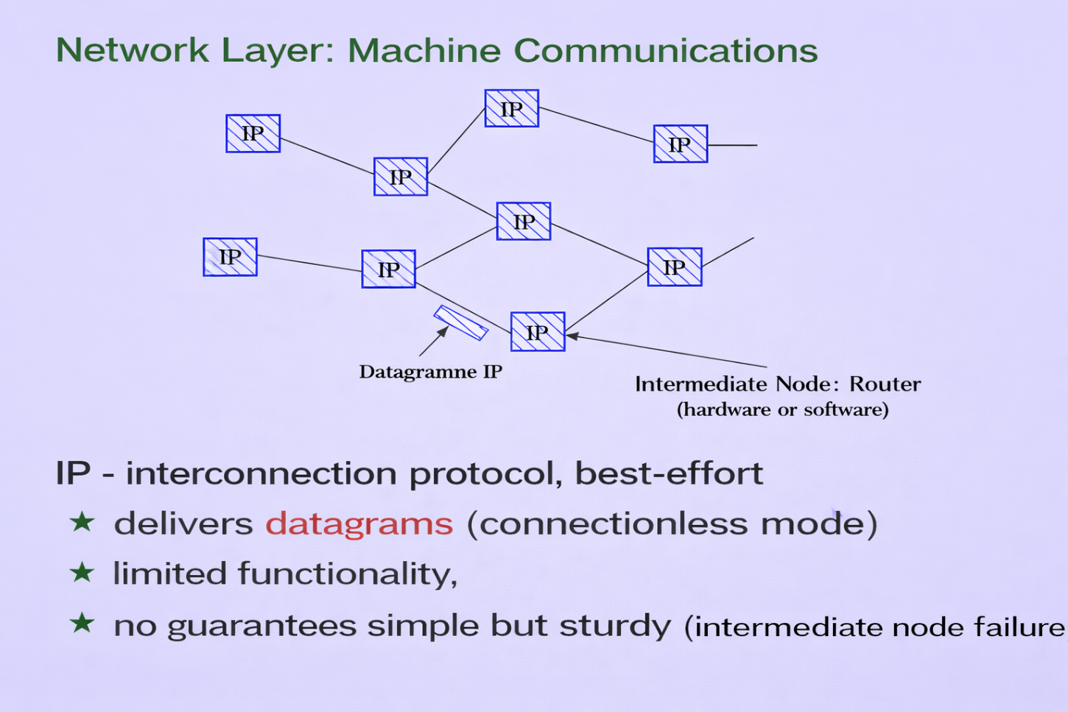
TCP/IP Model

Slide 22
TCP/IP Model
The name “network access layer” has a very broad meaning and can sometimes be confusing. It is also known as the host-to-network layer. This layer includes all the physical and logical elements required to establish a physical connection. It covers details related to network technologies, as well as the functions normally associated with the Physical and Data Link layers of the OSI model.

Slide 23
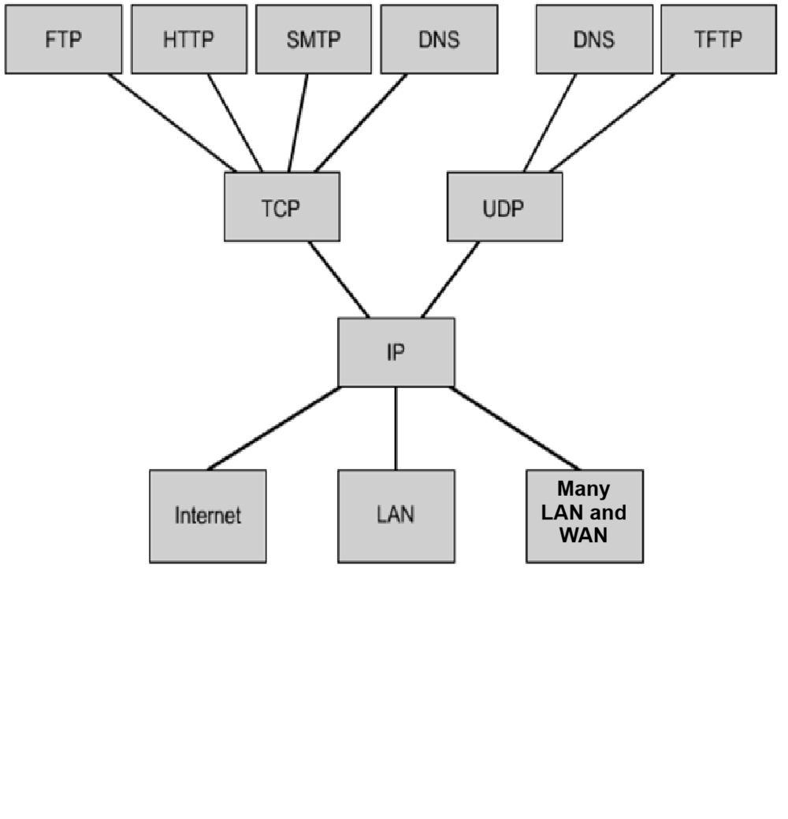
TCP/IP Model
The figure shows some common protocols defined by the layers of the TCP/IP reference model. Among the most widely used application-layer protocols are:
  FTP (File Transfer Protocol)
  HTTP (Hypertext Transfer Protocol)
  SMTP (Simple Mail Transfer Protocol)
  DNS (Domain Name System)
  TFTP (Trivial File Transfer Protocol)
The main protocol of the Internet layer is:
  IP (Internet Protocol)
The most common protocols at the transport layer include:
  TCP (Transmission Control Protocol)
  UDP (User Datagram Protocol)
The network access layer refers to the particular technologies employed within a specific network environment.

Slide 24
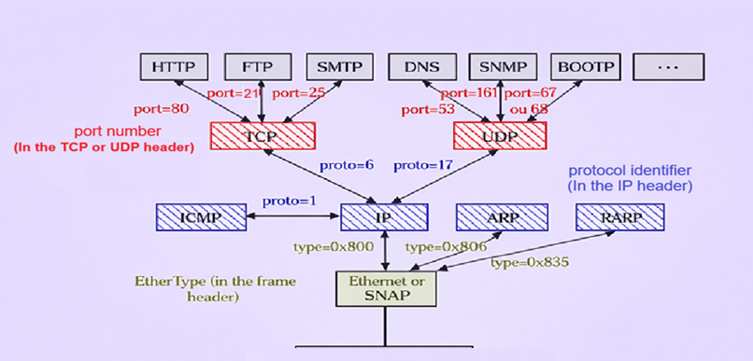
TCP/IP Model

Slide 25
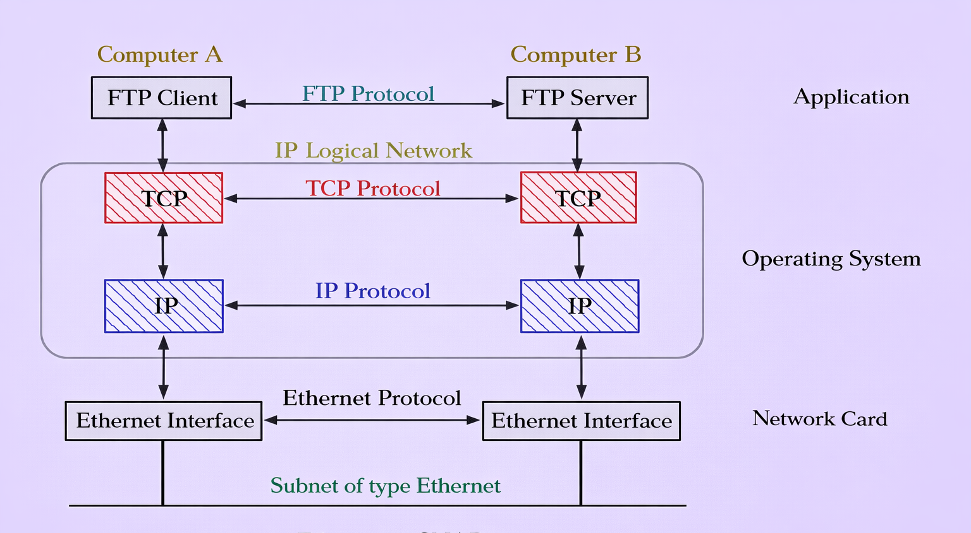
TCP/IP Model
Two machines on the same network.

Slide 26
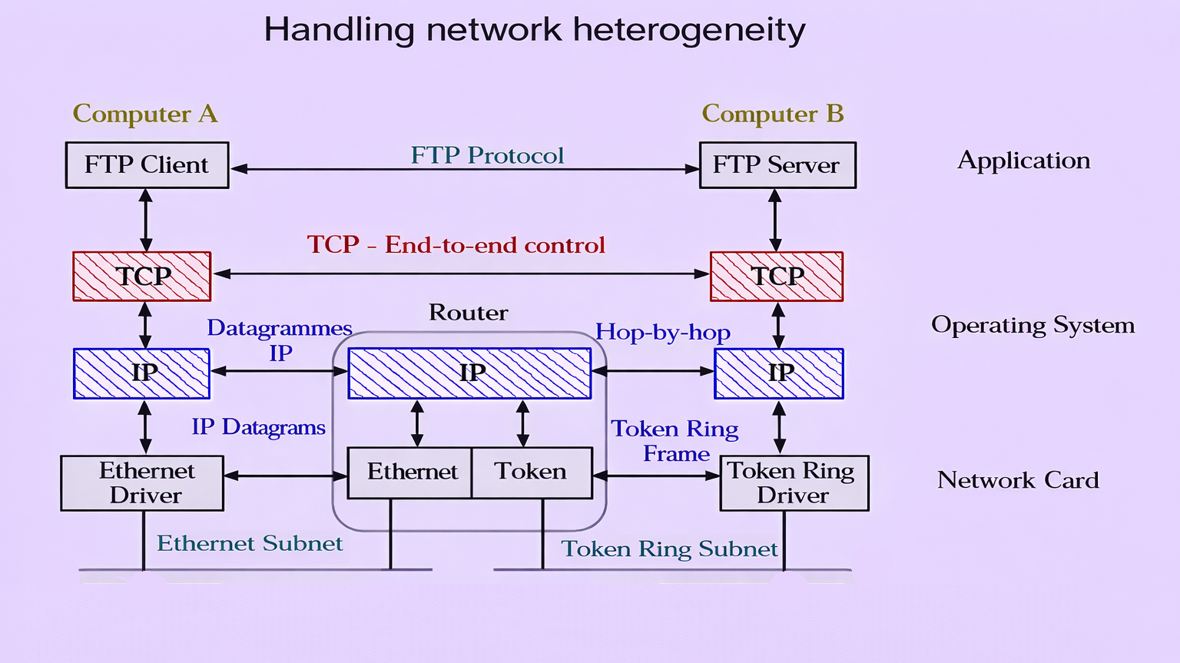
TCP/IP Model

Slide 27
TCP/IP Model
The ping command uses special IP packets called ICMP (Internet Control Message Protocol) to send echo requests to a selected destination. Each packet sent expects a reply.
The response shows whether the communication was successful and measures the round-trip delay between the source and destination devices. This information is used to evaluate connectivity with the target system. The ping command is commonly used to check network interface operation, TCP/IP settings, and general network connectivity.

Slide 28
TCP/IP Model

Slide 29
TCP/IP Model
The ping command can be used for different purposes:
    ping 127.0.0.1 – This command checks the internal loopback function and helps confirm that the local TCP/IP configuration is working correctly.
    ping the IP address of a host computer – When sent to a device on the network, this command checks the host’s TCP/IP address configuration and confirms connectivity with that device.
    ping the IP address of the default gateway – Running the ping command toward the default gateway is used to verify that the router connecting the local network to other networks is reachable.

Slide 30
References
Andrew S. Tanenbaum Computer Networks
Behrouz A. Forouzan Data Communications and Networking
William Stallings Data and Computer Communications
Cisco Networking Academy Introduction to Networks
ISO/OSI Reference Model Documentation
TCP/IP Standards (RFC documents)

