Slide 1

People’s Democratic Republic of Algeria
National Polytechnic School of Oran – Maurice Audin
Department of Computer Systems Engineering
OSI Model
Layer 1
Dr.BOUMEDJOUT AMAL
Email: amal.boumedjout@enp-oran.dz

Slide 2
Course Objective
  By the end of the course, students will be able to
    Understand the role of the Physical Layer in network communication
    Explain how bits are transmitted using electrical, optical, and wireless signals
    Understand basic physical concepts such as voltage, noise, attenuation, and grounding
    Distinguish between analog and digital signals
    Describe common signal encoding techniques
    Understand synchronization and timing in data transmission
    Explain the impact of physical media on bandwidth and throughput

Slide 3
Layer 1: Electronics and Signaling
The physical layer is in charge of data transmission by defining the electrical characteristics between the source and the destination. Once the electricity reaches a building, it is delivered to workstations, servers, and network devices through cables hidden in walls, floors, and ceilings, data is also carried through wires.
This data can be text, images, sound, or video. It is carried as electrical signals over copper cables or as light signals over fiber-optic cables.

Slide 4
Layer 1: Electronics and Signaling
Voltage
Voltage, also known as electromotive force (EMF), is an electric potential created by the separation of electrons and protons. It causes attraction between opposite charges and repulsion between similar charges.
This process occurs in a battery, where a chemical reaction releases electrons from the negative terminal and pushes them toward the positive terminal. Voltage can also be generated by friction (static electricity), by magnetism (electric generators), or by light (photocells).

Slide 5
Layer 1: Electronics and Signaling
As voltage rises, the electrical potential increases, which produces a higher current. As the current moves through a circuit, it faces resistance, much like a valve reduces the flow of water. the current level depends on the impedance (resistance) of the material.

Slide 6
Layer 1: Electronics and Signaling
In any AC or DC electrical circuit, electrons travel from a negatively charged source toward a positively charged source. Electrical current generally flows along the path with the least resistance. Metals such as copper, which present low resistance, are commonly used as conductors. Materials like glass, rubber, and plastic, however, offer high resistance and act as insulators. These materials are used to cover conductors in order to prevent electric shock, short circuits, and fire hazards.

Slide 7
Layer 1: Electronics and Signaling
Main purpose of grounding?
To prevent dangerous voltage levels from developing as a result of an internal wiring fault.

Slide 8
Layer 1: Electronics and Signaling
A signal can be defined as a specific electrical voltage, a sequence of light pulses, or a modulated electromagnetic wave. These forms are all able to transport network data.

Slide 9
Layer 1: Electronics and Signaling
sine wave has two main characteristics: amplitude (A), which describes its maximum and minimum values, and period (T), which is the time needed to complete a single cycle. The wave frequency (f) is calculated using the equation f = 1/T.
One category of signal is the analog signal. It has the following features:
    It varies in a continuous manner.
    Its voltage level changes constantly with time.
    It commonly appears in natural systems.

Slide 10
Layer 1: Electronics and Signaling
A digital signal is another category of signal and is defined by the following characteristics:
      Its voltage-time representation is discontinuous or step-based.
      It is mainly associated with technological systems rather than natural phenomena.

Slide 11
Layer 1: Electronics and Signaling
In digital signals, the amplitude remains fixed, but the pulse width and frequency can change. Signals generated by modern digital devices are similar to a square wave, moving almost instantly from a low-voltage level to a high-voltage level without any oscillation.

Slide 12
Layer 1: Electronics and Signaling
Modern computer networks rely more and more on digital systems.
The fundamental element of information is a binary symbol, called a bit or pulse. In electrical transmission media, a bit is an electrical signal used to represent the binary digits 1 and 0. A binary 0 may correspond to a voltage level such as 0 volts, while a binary 1 may correspond to +5 volts. These signals can also represent more complex data. Reference signal grounding is an essential concept for all network media that transmit messages using voltage.

Slide 13
Layer 1: Electronics and Signaling
In optical signaling, a binary 0 indicates low light intensity or no light at all(darkness), while a binary 1 indicates a higher light intensity or more complex light patterns.

Slide 14
Layer 1: Electronics and Signaling
In wireless signaling, a binary 0 can be represented by a brief wave burst, whereas a binary 1 can be represented by a longer wave burst.

Slide 15
Layer 1: Electronics and Signaling
There are six factors that can affect a bit:
      Propagation
      Attenuation
      Reflection
      Noise
      Synchronization issues Collisions

Slide 16
Layer 1: Electronics and Signaling
propagation means transmission. When a network interface sends an electrical voltage or a light pulse through a physical medium, the square pulse, made of waves, moves along that medium. Propagation describes how a quantity of energy that represents a bit travels from one location to another. The propagation speed depends on the medium material, its physical structure, and the pulse frequency.

Slide 17
Layer 1: Electronics and Signaling
Attenuation is the loss of signal strength. It may occur when a cable extends beyond its maximum length. a voltage signal carrying one bit loses amplitude as energy is dissipated into the cable. Although using high-quality materials, (such as copper rather than carbon) and appropriate cable design can reduce electrical attenuation, some loss is inevitable due to electrical resistance.
Optical signals may also lose strength due to attenuation. as a light pulse carrying one bit travels along an optical fiber, part of its light energy can be absorbed and lost within the fiber. Selecting the proper wavelength, or light color, can help minimize this loss. The use of single-mode or multimode fiber, as well as the type of glass used in the fiber, also plays a role in reducing attenuation. However, a certain amount of signal loss is unavoidable.
Radio and microwave transmissions are also affected by attenuation, as certain molecules in the atmosphere absorb and disperse these waves. This attenuation can impact network communication by limiting how far a message can travel.

Slide 18
Layer 1: Electronics and Signaling
The issue can be resolved by carefully choosing network media and by adopting designs that reduce attenuation. One approach is to replace the transmission medium, while another is to place a repeater at an appropriate distance. Repeaters are available for electrical, optical, and wireless signals.

Slide 19
Layer 1: Electronics and Signaling
Reflection also occurs in electrical signals. When voltage pulses, or bits, reach a discontinuity, If this reflected energy is not properly managed, it can interfere with other bits.
This phenomenon also occurs with radio waves and microwaves, as they pass through different layers of the atmosphere.
Reflection also affects optical signals. These signals are reflected whenever they reach a discontinuity in the glass fiber, such as when a connector is attached to a device.

Slide 20
Layer 1: Electronics and Signaling
Noise is any unwanted interference that affects a voltage, optical, or electromagnetic signal. Every electrical signal includes some noise. Therefore, it is important to preserve the highest possible signal-to-noise ratio.

Slide 21
Layer 1: Electronics and Signaling
Near-End Crosstalk (NEXT) and Far-End Crosstalk (FEXT)
Electrical noise on a cable that results from signals carried by other wires in the same cable is called crosstalk. Near-End crosstalk refers to interference that occurs close to the source of transmission. When two untwisted wires are positioned close together, energy from one wire may transfer to the neighboring wire, and vice versa.This interaction can generate noise at both ends of the connected cable. Several types of crosstalk must be considered during network planning and design.

Slide 22
Layer 1: Electronics and Signaling
Dispersion, jitter, and latency are three different phenomena that can affect a bit. These phenomena are grouped together because they all relate to the same issue: bit synchronization.

Slide 23
Layer 1: Electronics and Signaling
Dispersion is the spreading of pulses over time. It caused by the type of transmission medium. If dispersion becomes too high, one bit may overlap with the next and become confused with the surrounding bits.

Slide 24
Layer 1: Electronics and Signaling
All digital systems operate in a synchronized manner, meaning that their functions are governed by clock signals. These clock signals enable the processor to determine which data is stored in memory and allow the network interface card to transmit bits. If the clock of the source host is not synchronized with that of the destination host, which is often the case, synchronization jitter occurs. As a result, some bits may reach the destination slightly earlier or later than expected.
Jitter: Variation in the transmission time of a signal

Slide 25
Layer 1: Electronics and Signaling
Latency, defined as a delay in data transmission, may result from two main factors.
First, Einstein’s theory of relativity states that nothing can move faster than the speed of light in a vacuum (3 × 10⁸ m/s). Wireless network signals propagate at a speed slightly lower than this value. In copper-based transmission media, network signals travel at speeds ranging from 1.9 × 10⁸ m/s to 2.4 × 10⁸ m/s. In optical fiber, these signals propagate at approximately 2 × 10⁸ m/s. Consequently, a bit always needs a certain amount of time to reach its destination over a given distance.
In addition, when bits pass through electronic devices, transistors and other components introduce additional latency. Latency can be reduced through the appropriate use of network interconnection devices, various encoding strategies, and suitable layer protocols.

Slide 26
Layer 1: Electronics and Signaling
A collision occurs when two bits sent by different computers are transmitted at the same time on the same shared medium. n the case of copper wires, the voltages of the two binary signals combine and create a third voltage level. Such a voltage level is invalid in a binary system that recognizes only two voltage levels. Consequently, the corrupted bits are effectively destroyed.

Slide 27
Layer 1: Electronics and Signaling
Collisions can be managed in several ways. One approach is to detect them by defining rules when they occur, as used in Ethernet technology. Another approach is to prevent collisions by allowing only one computer to transmit at a time in a shared-media environment. This requires a computer to possess a specific binary configuration known as a transmission token, as used in Token Ring and FDDI technologies.
In certain situations, However, an excessive number of collisions can slow down network performance.

Slide 28
Basics of Network Signal Encoding
Sending a message over a long distance requires solving two main problems: the method used to encode or modulate the message, and which medium or carrier is used for transmission.

Slide 29
Basics of Network Signal Encoding
Across different periods of history, humans have used many methods to transmit messages over long distances, such as runners, horse riders, optical telescopes, carrier pigeons, and smoke signals. Each method required a specific form of encoding. For example, smoke signals could be used to announce the presence of prey, while a message symbolizing a smiling face carried by a carrier pigeon could indicate that someone had arrived safely. Later, the invention of Morse code greatly transformed communication. The alphabet was encoded using only two symbols: the dot and the dash. For example, ··· --- ··· corresponds to SOS, the universal distress call. Today, modern telephones, fax machines, AM, FM, and shortwave radio systems, as well as television, all use electronically encoded signals. In general, these devices modulate waves from different parts of the electromagnetic spectrum.

Slide 30
Basics of Network Signal Encoding
There are several types of encoding:
    TTL (Transistor-Transistor Logic)
    NRZ-L (Non-Return to Zero Level)
    NRZI (Non-Return to Zero Inverted encoding)
    MLT-3 (Multi-Level Threshold)
    Manchester (TX+) and Manchester (TX−), which are differential signals used in 10Base-T Ethernet networks.

Slide 31
Basics of Network Signal Encoding
NRZ signaling does not use bandwidth efficiently and is sensitive to electromagnetic interference. In addition, the boundaries between individual bits may be lost when long sequences of consecutive 1 or 0 are transmitted. In such cases, no voltage transition can be detected on the transmission medium.

Slide 32
Basics of Network Signal Encoding
Manchester Encoding
Manchester encoding does not represent bits as constant voltage levels. Instead, it uses voltage transitions to encode binary values.
For example, a transition from a low voltage to a high voltage represents the binary value 1. A transition from a high voltage to a low voltage represents the binary value 0.

Slide 33
Basics of Network Signal Encoding
These transitions are used to ensure that bit timing at the receiving nodes is synchronized with that of the transmitting node. Although Manchester encoding is not sufficiently efficient for higher data transmission rates, it is the signaling technique employed by 10Base-T Ethernet.

Slide 34
Basics of Network Signal Encoding
Convert the following bit sequence into the following codes:
NRZ, NRZM, Manchester
11011001, 10011010

Slide 35
Basics of Network Signal Encoding
As higher transmission speeds are employed on the mediumthe risk of data corruption increases. The use of encoding groups enables more effective error detection, as demonstrated by 4B/5B encoding. For example, the code sequence 10101 may represent the data sequence 0011.

Slide 36
Basics of Network Signal Encoding
The advantages of using code groups include:
      Reduced bit-level errors
      Limitation of the effective energy
      transmitted through the medium
      Improved distinction between data bits
      and control bits

Slide 37
Basics of Network Signal Encoding
Distinguishing Data Bits and Control Bits
Code groups include three types of symbols:
Data symbols: symbols that represent the frame data as it is delivered to the physical layer.
Control symbols: special codes inserted by the physical layer to manage transmission. This includes end-of-frame symbols and idle symbols.
Invalid symbols: symbols that contain unauthorized variations on the medium. The reception of an invalid symbol indicates a frame error.

Slide 38
Basics of Network Signal Encoding
One method used for frame detection is to begin each frame with a specific signal variation representing bits that the physical layer recognizes as the start of a frame (11000). Another bit variation indicates the end of the frame (01101). Signal bits that are not framed in this way are ignored by the physical layer standard in use.

Slide 39
Basics of Network Signal Encoding
Differential Manchester encoding is used in Token Ring networks.
MLT-3 encoding is used in Fast Ethernet networks (100Base-TX).
Other encoding techniques are also used, such as 4B/5B, AMI, and bipolar AMI…..

Slide 40
Data Transmission Capacity
Different physical media support bit transfer at different speeds. Data transfer can be measured in three ways:
    Bandwidth
    Throughput
    Application throughput

Slide 41
Data Transmission Capacity
Bandwidth
Bandwidth refers to the amount of data that a medium can transmit. Digital bandwidth shows how much information can be sent from one location to another over a period of time. It is commonly measured in kilobits per second (Kbit/s) or megabits per second (Mbit/s).
The effective bandwidth of a network depends on several factors, such as the physical medium used and the techniques applied to send and receive network signals.

Slide 42
Data Transmission Capacity
Throughput
Throughput is the measure of bit transfer over the medium during a given period. Due to a number of factors, throughput does not generally correspond to the bandwidth specified in physical layer implementations such as Ethernet.
Several factors can affect throughput, including how much data is being sent, the kind of data, and how many devices are active on the network. In shared network designs like Ethernet, devices must share the same mediumAs a result, the throughput available to each device decreases as medium usage increases.

Slide 43
Data Transmission Capacity
Application Throughput
Application throughput is a third way to measure data transfer. It shows how much useful data is sent during a specific period of time and therefore represents the most meaningful measure for network users.

Slide 44
Data Transmission Capacity
Unlike throughput, which counts all transmitted bits, application throughput considers only the useful data by excluding protocol overhead. It is therefore the throughput reduced by the traffic used for session creation, acknowledgments, and encapsulation.

Slide 45
Data Transmission Capacity
As an illustration, consider two hosts on a local area network transferring a file. The available LAN bandwidth is 100 Mbit/s. Due to medium sharing and protocol overhead, the throughput between the hosts is reduced to 60 Mbit/s. After including the overhead from TCP/IP processing, the actual data rate received by the destination host, called application throughput, is only 40 Mbit/s.

Slide 46
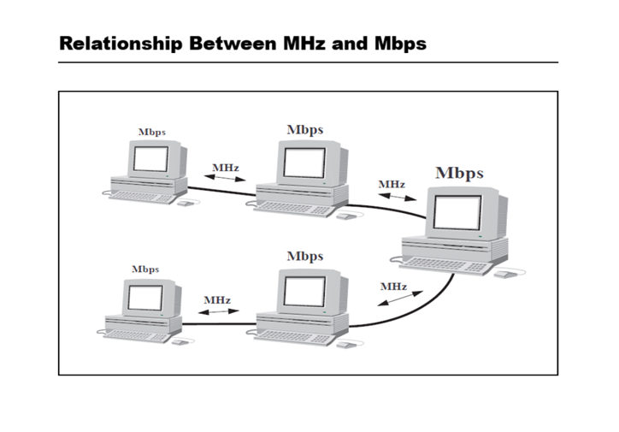
Bandwidth

Slide 47
Bandwidth
What is the relationship between Megahertz (MHz) and Megabits per second (Mbps)?
Computers use bits to represent data, but they are connected by cables. On these cables, the data sent by computers is converted into an electrical signal that occupies a certain bandwidth.
This is necessary because cables can only carry electrical signals, which are defined by frequency and bandwidth measured in hertz. Computers, however, work only with binary data made of “0” and “1”.
Therefore, a network interface card is required between the computer and the transmission medium (the cable). This card includes an encoder that transforms the stream of bits from the computer into an electrical signal with a specific bandwidth, which is then transmitted over the cable.

Slide 48
Bandwidth
The conversion factor expresses the relationship between Mbps and MHz.
Encoding Technique | Conversion Factor | Mbps = MHz
Manchester | 1 | 1 = 1
NRZI | 0.5 | 2 = 1
MLT-3 | 0.25 | 4 = 1

Slide 49
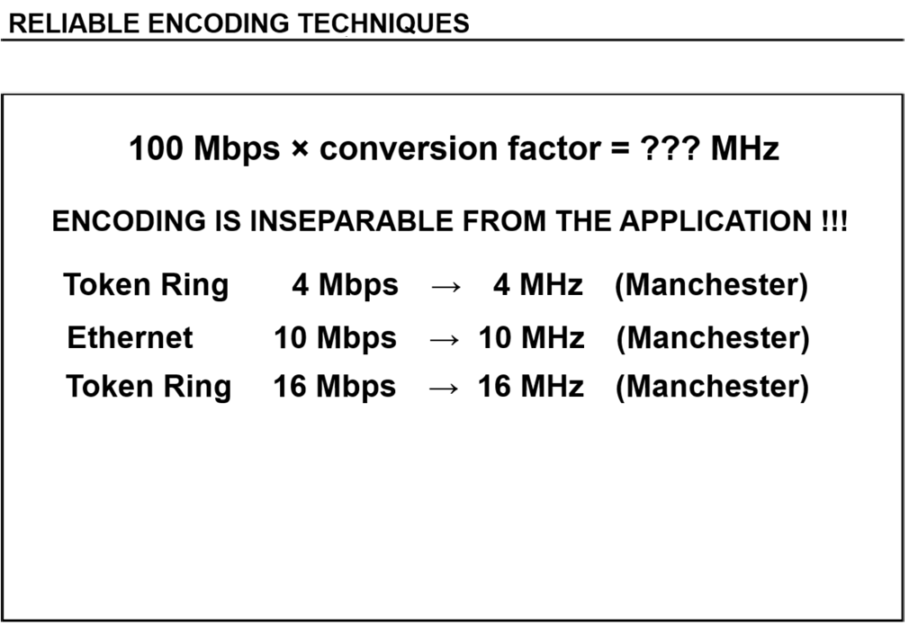
Bandwidth

Slide 50
Bandwidth
Encoding Techniques | Conversion Factor | Effect of Encoding | Mbps = MHz
Manchester | 1 |  | 100 = 100
NRZ-I + 4B5B | 0.5 | One synchronization bit is added every 4 bits. 100 Mbps + (100/4) = 125 Mbps | 125 = 62.5
MLT-3 + 4B5B | 0.25 | One synchronization bit is added every 4 bits. 100 Mbps + (100/4) = 125 Mbps | 125 = 31.25
CAP-16 |  | Very complex encoding technique | 155 = 25.8
Comparison Manchester = a single car
        NRZ-I = a single bus
        MLT-3 = a double-decker bus

Slide 51
References
Cisco Networking Academy Introduction to Networks – Physical Layer concepts
Behrouz A. Forouzan Data Communications and Networking
Andrew S. Tanenbaum Computer Networks
IEEE Standards IEEE 802.3 (Ethernet), IEEE 802.5 (Token Ring – historical reference)
Course Slides and Instructor Materials Layer1: Electronics and Signaling

