Slide 1

People’s Democratic Republic of Algeria
National Polytechnic School of Oran – Maurice Audin
Department of Computer Systems Engineering
Ethernet Technologies
Dr.BOUMEDJOUT AMAL
Email: amal.boumedjout@enp-oran.dz

Slide 2
Course Objective: Introduction to Ethernet
The aim of this course is to help students understand how Ethernet works and why it is widely used in local area networks. By the end of the course, students will be able to:
    Explain what Ethernet is and its role in computer networks.
    Describe how Ethernet has developed over time to support higher data speeds.
    Understand the basic IEEE Ethernet standards and their link to the OSI model.
    Identify the main tasks of the LLC and MAC sublayers.
    Understand how devices share the network medium and how collisions are managed.
    Describe the structure of an Ethernet frame and how errors are detected.
    Recognize different Ethernet speeds and transmission media.

Slide 3
Introduction to Ethernet
A large part of Internet traffic begins and finishes on Ethernet connections. Since it was created in the 1970s, Ethernet has changed over time to support faster local networks. When fiber-optic technology appeared, Ethernet adapted to use greater capacity and fewer transmission errors.

Slide 4
Introduction to Ethernet
The success of Ethernet can be attributed to the following factors:
    Simplicity of design and ease of maintenance
    Ability to incorporate emerging technologies
    Reliable operation
    Reduced costs for installation and upgrades

Slide 5
Introduction to Ethernet
At first, the objective was to enable at least two hosts to share the same transmission medium without causing signal conflicts. The problem of multiple-user access to a common medium was examined in the early 1970s at the University of Hawaii. A network system known as Alohanet was created to offer multiple stations across the Hawaiian Islands controlled access to a shared radio channel. This research later served as the basis for the Ethernet medium access technique called CSMA/CD.

Slide 6
Introduction to Ethernet
In 1985, the IEEE group in charge of local and metropolitan networks published a set of standards for local area networks. These standards belong to the 802 family, and Ethernet is defined as standard 802.3.
The IEEE intended its standards to be compatible with the ISO and the OSI model. For this reason, IEEE 802.3 was designed to support the functions of the physical layer and the lower part of the data link layer of the OSI model. As a result, minor modifications were made to the original Ethernet specification.

Slide 7
Introduction to Ethernet
The 10 Mbit/s Ethernet bandwidth was sufficient for the personal computers of the 1980s, which had limited processing capabilities. However, in the early 1990s, improvements in computer performance and the growth of file sizes led to the appearance of network bottlenecks. Most of these problems were due to limited bandwidth. In 1995, the IEEE introduced a 100 Mbit/s Ethernet standard. This was followed by the release of Gigabit Ethernet standards in 1998 and 1999.

Slide 8
Introduction to Ethernet
Overall, Ethernet standards remain compatible with the original Ethernet model. An Ethernet frame can be transmitted from a PC’s network card through an older 10 Mbit/s coaxial cable, then carried over a 10 Gbit/s Ethernet fiber-optic connection, before arriving at a 100 Mbit/s network interface. As long as the frame stays within Ethernet networks, it remains unchanged.
For this reason, Ethernet is regarded as highly scalable. Network bandwidth can be increased several times without requiring modifications to the Ethernet technology.

Slide 9
IEEE Ethernet Naming Rules
Ethernet operates at speeds of 10, 100, 1,000, and 10,000 Mbit/s. The basic frame structure and the IEEE sublayers within OSI Layers 1 and 2 remain the same for all Ethernet variants.
When Ethernet is expanded to support a new transmission medium or increased capacity, the IEEE issues an additional update to the 802.3 standard. These updates are marked by one or two letters (such as 802.3u) and are also assigned a brief descriptive identifier.

Slide 10
IEEE Ethernet Naming Rules
The abbreviated description includes the following elements:
  A numeric value indicating the transmission rate in Mbit/s
  Alphabetic characters indicating the use of baseband signaling
  One or more letters that identify the transmission medium. For example, F represents fiber-optic cable, while T represents unshielded twisted-pair copper cable
Ethernet operates using baseband signaling, which utilizes the entire bandwidth of the transmission medium. The data signal is transmitted directly over the medium.

Slide 11
IEEE Ethernet Naming Rules
Principe:
When the link length is limited to a few hundred meters, information can be transmitted over the communication medium without converting the digital signal into an analog form.
This transmission method, which does not require frequency translation through modulation, is known as baseband transmission.
Baseband transmission is mainly applied in local area networks, where it supports high data rates over short distances. It relies on metallic transmission media, including twisted-pair cables and coaxial cables.

Slide 12
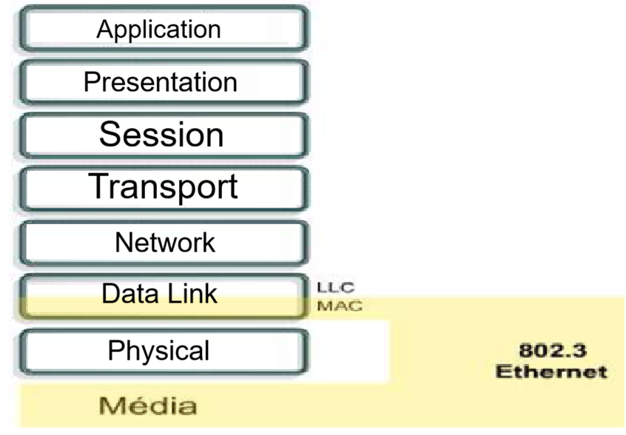
Ethernet and the OSI Model
Ethernet operates in two specific parts of the OSI model: the lower section of the data link layer, known as the MAC sublayer, and the physical layer.

Slide 13
Ethernet and the OSI Model
Limitations of the Physical Layer | Functions of the Data Link Layer
It cannot interact with upper layers. | Connects to upper layers through the LLC protocol
Cannot identify devices | Uses addressing schemes to identify devices
Works only with raw bit streams | Uses frames to organize bits into groups
Cannot identify the sender when several devices transmit at the same time | Uses MAC addresses to identify transmission sources

Slide 14
Ethernet and the OSI Model
LLC (Logical Link Control) Sublayer
    Is mostly independent of the physical equipment used for communication
    rovides the connection to higher-level layers
    Encapsulates network layer packets into frames
    Identifies the type of network layer protocol

Slide 15
Ethernet and the OSI Model
In Ethernet networks, the IEEE 802.2 standard defines the functions of the LLC (Logical Link Control) sublayer, while the IEEE 802.3 standard specifies the functions of the MAC (Media Access Control) sublayer and the physical layer.
The LLC is implemented at the software level and operates independently of the underlying hardware. Within a computer system, the LLC may be viewed as part of the network adapter driver software.The network adapter driver is a software component that communicates directly with the network interface hardware, enabling the transfer of data between the physical transmission medium and the MAC sublayer.

Slide 16

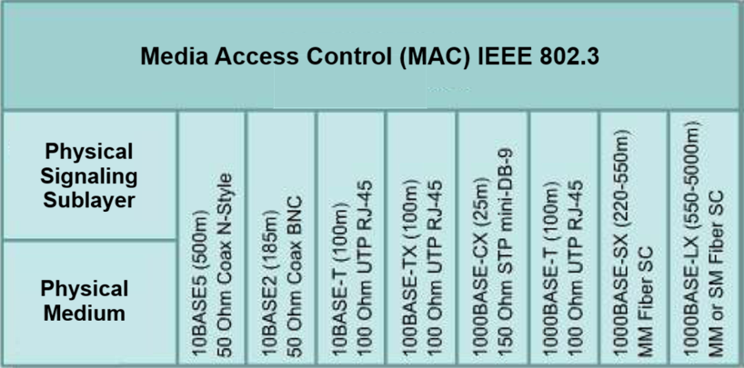
Ethernet and the OSI Model

Slide 17
MAC Sublayer
The MAC sublayer is the lower Ethernet sublayer of the data link layer. It is mainly implemented in hardware on the network adapter. The Ethernet MAC sublayer is responsible for two primary tasks:
data encapsulation and regulation of access to the physical medium.
Data encapsulation includes threefundamental functions:
    Frame delimitation
    Addressing
    error detection

Slide 18
MAC Sublayer
Data encapsulation is the process of assembling frames before they are sent and checking them when they are received.
During frame construction, the MAC layer adds a header and a trailer to the Layer 3 protocol data unit. Framing improves the placement of bits onto the transmission medium and facilitates their reassembly at the receiving node.
The framing process defines clear delimiters that indicate the beginning and end of a frame. This ensures synchronization between transmitting and receiving nodes.
Encapsulation also provides addressing at the data link layer. Each Ethernet frame header includes a physical address (MAC address), which allows the frame to reach the correct destination.

Slide 19
MAC Sublayer
Data encapsulation also provides a mechanism for error detection.
  Each Ethernet frame carries a trailer that includes a Cyclic Redundancy Check (CRC) calculated from the frame data.
  When a frame is received, the destination device generates its own CRC and compares it with the one included in the frame.
  If both CRC values are identical. the frame is considered to have been received without errors.

Slide 20
MAC Sublayer
The MAC sublayer is responsible for controlling how frames are placed onto and removed from the transmission medium. It manages access to the medium by starting frame transmissions and enabling recovery when collisions interrupt communication. In classic Ethernet systems, the medium access method used is Carrier Sense Multiple Access with Collision Detection (CSMA/CD).

Slide 21

Ethernet Topology Evolution
Early Ethernet deployments operated in low-bandwidth LAN environments, where access to a shared medium was controlled by CSMA/CD. Ethernet operated using both a logical bus topology at the data link layer and a physical bus topology. With the growth of local area networks and the demand for LAN services increased, this physical design became a limitation for network growth.

Slide 22
Ethernet Topology Evolution
Early Ethernet networks replaced thick and thin coaxial cables with initial categories of unshielded twisted pair cabling. When compared to coaxial cables, unshielded twisted pair cables are lighter, easier to deploy, and more economical.
The original topology was replaced by a star topology based on hubs. Hubs act as central connection points. When a frame is received on one port, it is forwarded to all other port so that all LAN segments receive the frame. as the network could remain operational even if a single cable failed. However, sending frames to all ports did not remove collision issues.

Slide 23
Ethernet Topology Evolution
The use of switches in Ethernet networks replaced hubs and greatly enhanced LAN performance. Switches appeared with the introduction of 100BASE-TX Ethernet. They control data transmission by isolating each port and forwarding frames only to their intended destination, when this information is available, instead of sending every frame to all devices. This approach reduces the risk of collisions. Later, the introduction of full-duplex operation, where a link supports both transmitted and received signals at the same time, allowed the development of Gigabit Ethernet.

Slide 24
The Frame: Packet Encapsulation
The Ethernet frame structure encapsulates the transmitted message by adding a header and a trailer to the Layer 3 protocol data unit. The Ethernet header and trailer consist of several information components used by the Ethernet protocol.
Each component of the frame is known as a field. Two Ethernet framing methods are defined: the original IEEE 802.3 standard and the updated IEEE 802.3 Ethernet standard.
They mainly include the addition of a Start Frame Delimiter (SFD) and a slight modification to the Type field so that it can also indicate the frame length, as shown in the figure.

Slide 25
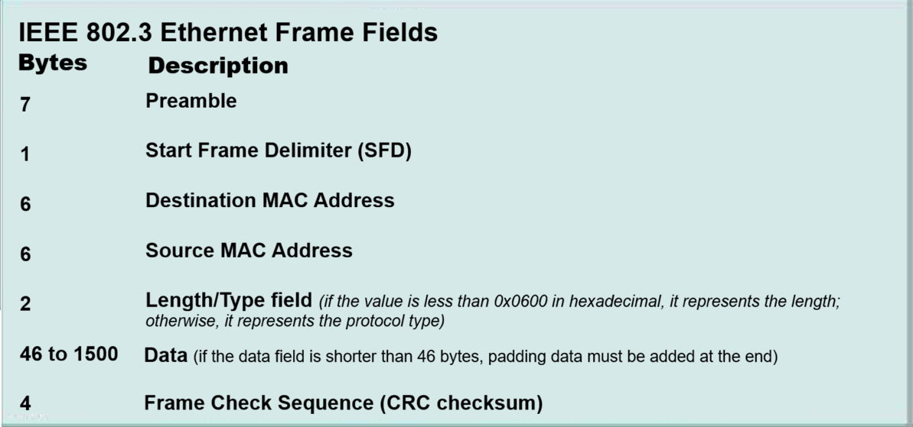
IEEE 802.3 Frame
IEEE 802.3

Slide 26
Ethernet Frame
Ethernet Frame
The initial Ethernet specification defined a minimum frame length of 64 bytes and a maximum length of 1,518 bytes. This measurement covered all the bytes in the field from the Destination MAC address through the Frame Check Sequence. The Preamble and Start Frame Delimiter were not included in the frame size definition.
The IEEE 802.3ac standard, introduced in 1998, increased the maximum frame size to 1,522 bytes. This adjustment was made to support Virtual Local Area Network (VLAN) technology.

Slide 27
Ethernet Frame
The receiving device rejects a frame if its length is less than the minimum limit or greater than the maximum limit. Such frames are commonly caused by collisions or other unwanted signals and are treated as invalid.

Slide 28
References
Forouzan, B. A., Data Communications and Networking, McGraw-Hill.
Tanenbaum, A. S., & Wetherall, D. J., Computer Networks, Pearson.
Kurose, J. F., & Ross, K. W., Computer Networking: A Top-Down Approach, Pearson.
Stallings, W., Data and Computer Communications, Pearson.
IEEE Computer Society, IEEE 802.3 Ethernet Standard.
IEEE Computer Society, IEEE 802.2 Logical Link Control (LLC).
Cisco Networking Academy, Introduction to Networks (ITN).

