Slide 1

People’s Democratic Republic of Algeria
National Polytechnic School of Oran – Maurice Audin
Department of Computer Systems Engineering
Switches
Dr.BOUMEDJOUT AMAL
Email: amal.boumedjout@enp-oran.dz

Slide 2
Course Objective
By the end of the course, students will be able to
  Understand the role of Ethernet switches in local area networks
  Explain how frames are forwarded within a switched network
  Describe the process of MAC address learning
  Understand how forwarding tables are built and used
  Explain the purpose and operation of the ARP protocol
  Understand how IP addresses are mapped to MAC addresses
  Describe how data is delivered correctly between network devices

Slide 3
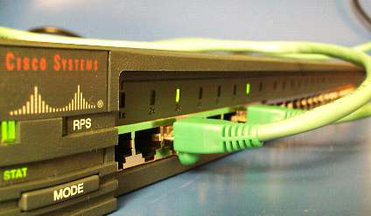
Ethernet switch
In the early development of local area network technologies, bridges were widely employed to connect separate physical segments within a network. A conventional bridge was typically limited to two interfaces, each serving as a connection point between distinct network segments.
A switch can be configured with numerous interfaces, depending on how many network segments must be connected. Like bridges, switches examine the characteristics of incoming data frames transmitted by network hosts. The extracted information is then leveraged to populate forwarding tables, allowing the switch to determine where data should be directed within the network.

Slide 4
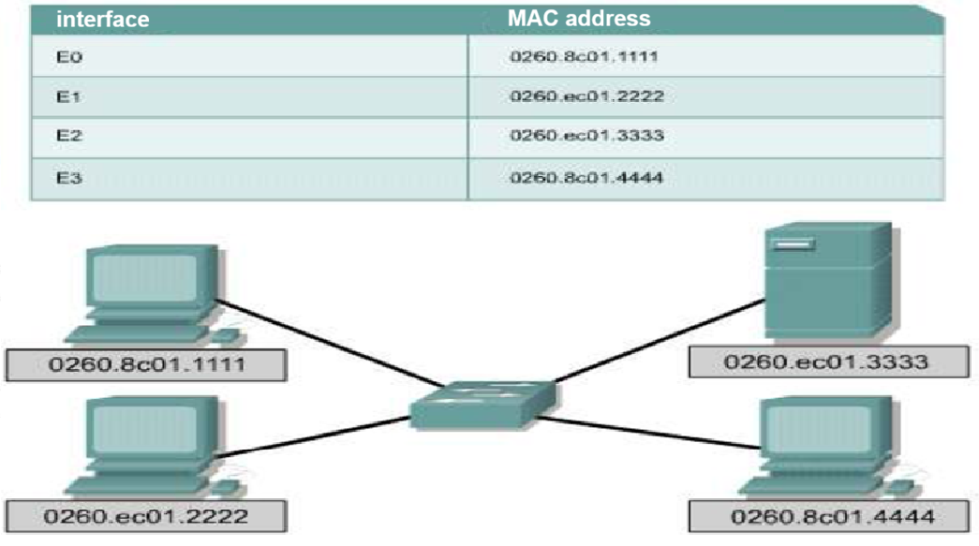
switch

Slide 5
switch
Ethernet switches forward frames in a targeted manner, sending each received frame only to the port connected to its intended destination. This selective forwarding can be viewed as the brief creation of a point-to-point communication path between the sending and receiving nodes.
The connection exists solely for the time required to transmit a single frame, during which both nodes effectively have exclusive use of the available bandwidth, forming a logical point-to-point link.
In practical terms, this temporary link does not require simultaneous coordination between the two nodes. This characteristic defines the point-to-point nature of host communication.
A device operating in full-duplex mode may transmit data whenever it has a frame ready, regardless of the immediate state of the receiving device. To support this behavior, a LAN switch temporarily stores incoming frames and forwards them to the appropriate output port once it becomes available.
This mechanism is known as store-and-forward switching.

Slide 6
switch
In store-and-forward mode, a switch first accepts the complete frame and performs an integrity check by examining the Frame Check Sequence (FCS). Only after this verification does it forward the frame to the output port corresponding to the destination host.
This approach allows network devices to transmit and receive data at the full capacity of the transmission medium, without having to wait for channel availability and without the risk of frame loss due to collisions or the overhead associated with collision handling.

Slide 7
switch
A network switch maintains an internal reference table, commonly referred to as the MAC table, which links destination MAC addresses to specific switch ports connected to network hosts. When a frame is received, the switch extracts the destination MAC address from the frame header and checks it against the entries stored in this table. If a corresponding port is identified, that port is selected as the output interface for forwarding the frame.
The table used by a switch to store MAC address information may be identified by several terms. In practice, it is most often called the forwarding table. Given that modern switching techniques are derived from the earlier concept of transparent bridging, the designation bridge table is still occasionally encountered. Consequently, many internal operations and processes implemented within LAN switches continue to use terminology that references bridging or routing.

Slide 8
switch
MAC
Address
table
Flash
Buffer
memory
Central Unit
Port Mac
OA
OB
0C
9 OD
Switching
logic

Slide 9
switchs
Operation of Switches
To perform their tasks, Ethernet LAN switches rely on five basic functions:
    Learning
    Aging
    Flooding
    Selective forwarding
    Filtering

Slide 10
switchs
Learning:
During normal operation, a switch automatically builds its MAC table by identifying the relationship between MAC addresses and switch ports.
When a frame is received, the switch examines the source MAC address and checks whether it is already stored. If the address is not found, the switch records it and associates it with the port on which the frame arrived. This information is then used to correctly deliver future frames to that device.

Slide 11
switchs
Aging:
To keep its MAC table accurate, a switch tracks how long each learned entry remains active. Every stored address is associated with a timer that starts when the entry is created.
If no traffic is observed from that device before the timer expires, the entry is marked for removal and will only be renewed when new frames are later received from the same host on the same interface.

Slide 12
switchs
Flooding:
If a switch has no matching entry for the destination MAC address, it temporarily sends the frame out through every port except the one it arrived on. This behavior, called flooding, ensures that the frame reaches its intended recipient even when the destination is unknown. The incoming interface is excluded because all hosts on that segment have already received the frame. Flooding is also used for frames addressed to the network’s broadcast MAC address.

Slide 13
switchs
Selective Forwarding:
Selective forwarding enables a switch to direct a frame based on its destination MAC address. When the address is already recorded in the MAC table, the switch uses the associated port to transmit the frame directly to the intended device.
This approach avoids unnecessary distribution of the frame across all ports and ensures that the data reaches only the correct node.

Slide 14
switchs
Filtering:
A switch may choose not to forward certain frames, a process referred to as filtering. For instance, a frame is never sent back through the port on which it was received. Frames that are damaged are also eliminated; when the CRC verification fails, the frame is discarded. Beyond error control, filtering is used to enforce security policies, enabling the switch to block traffic associated with particular MAC addresses or specific interfaces.

Slide 15
ARP Process
The ARP protocol fulfills two main roles:
    translating IPv4 addresses into their corresponding MAC addresses
    storing these address associations temporarily in a cache.

Slide 16
ARP Process
Resolution of IPv4 addresses to MAC addresses:
Every frame transmitted over a local area network must include a destination MAC address. When a packet is forwarded to the data link layer for frame encapsulation, the device consults a table maintained in its memory to determine the data link layer address associated with the destination IPv4 address. This table, known as the ARP table or ARP cache, is stored in the device’s random access memory (RAM).
Each record within the ARP table is composed of two elements: an Internet Protocol (IP) address and a Media Access Control (MAC) address. The relationship established between these elements constitutes a mapping, whereby the MAC address corresponding to a specific IP address can be retrieved. The ARP table maintains a cached record of these mappings for devices operating within the local area network (LAN).

Slide 17
ARP Process
To begin the operation, the sending device checks the ARP table for the MAC address linked to the destination IPv4 address.
If the mapping is available in the cache, the MAC address is inserted as the destination address in the encapsulating frame.
The frame is subsequently encoded and sent over the network medium.

Slide 18
ARP Process
ARP Table Maintenance:
The ARP table is maintained dynamically. A network device can acquire MAC address information through two primary approaches.
The first approach consists of passively observing traffic on the local network segment. Upon receiving frames from the network medium, the node extracts the source IP and MAC addresses and stores them as mappings within the ARP table. As network communication continues, the device gradually builds a collection of address pairs in its ARP cache.

Slide 19
ARP Process
The second approach that allows a device to obtain an address association is through the transmission of an ARP request using broadcast communication.
In this process, the ARP protocol distributes a Layer 2 broadcast frame to all devices within the Ethernet local area network. This frame includes an ARP request packet specifying the IP address of the destination host. When a receiving node detects that the requested IP address corresponds to its own, it sends an ARP reply back to the originating device using a unicast frame addressed to a single MAC address. This interaction results in the addition of a new entry to the ARP table.

Slide 20
ARP Process
Dynamic ARP table entries are associated with time-based aging mechanisms, similar to those applied to MAC address table entries on network switches.
When a device fails to receive any frames from a particular host before the aging timer expires, the related ARP entry is automatically removed from the table.

Slide 21
ARP Process
Frame Creation
What occurs when a node must construct a frame but the ARP cache does not contain the association between the destination IP address and its corresponding MAC address? When the ARP protocol receives a request to resolve an IPv4 address to a MAC address, it first checks whether this association already exists in the ARP cache. If no matching entry is found, the encapsulation of the IPv4 packet cannot be completed, and the Layer 2 mechanisms notify the ARP protocol that address resolution is required.
The ARP process then issues an ARP request packet in order to discover the MAC address of the destination device on the local network. If a device receiving the request determines that the target IP address matches its own, it responds by sending an ARP reply. As a result, a new entry is created in the ARP table, allowing packets destined for that IPv4 address to be encapsulated into frames.
If no device responds to the ARP request, the packet is discarded because frame creation is not possible. The encapsulation failure is reported to the higher layers of the device. In the case of an intermediate device, such as a router, the upper layers may choose to notify the source host by generating an error message within an ICMPv4 packet.

Slide 22
ARP Process: External Destination to the Local Network
Every frame transmitted on a local network must be delivered to a device connected to that network segment. If the intended IPv4 destination host is part of the same local network, the frame is addressed directly to the MAC address of that host.
When the destination IPv4 host resides outside the local network, the source node forwards the frame to the router interface that acts as the default gateway or next hop toward the intended destination. In this situation, the source node uses the gateway’s MAC address as the destination address for frames carrying IPv4 packets destined for hosts on on external networks.

Slide 23
ARP Process: External Destination to the Local Network
The gateway address of the router interface is stored in the IPv4 configuration of the host. When a host generates a packet destined for another system, it compares the destination IP address with its own IP address to determine whether both addresses belong to the same Layer 3 network. If the destination host is located on a different network, the source host invokes the ARP process to obtain the MAC address of the router interface acting as the gateway.
If the gateway entry is not present in the ARP table, the standard ARP procedure broadcasts an ARP request to discover the MAC address associated with the IP address of the router interface.

Slide 24
Proxy ARP:
Proxy ARP:
In certain circumstances, a host may attempt to resolve an IPv4 address that is not part of the local network’s address space. In such situations, the device sends an ARP request for an IPv4 address outside the local network, rather than requesting the MAC address of the gateway. To handle these requests, the router interface can operate using proxy ARP, responding on behalf of remote hosts.
As a consequence, the ARP cache of the requesting device associates external IP addresses with the MAC address of the gateway. Through the use of proxy ARP, the router interface effectively presents itself as the owner of the requested IPv4 address, thereby agreeing to forward the packets to their actual destination

Slide 25
ARP Process:
Address Mapping Removal
On each device, an aging mechanism within the ARP cache automatically removes entries that remain unused for a defined duration. The length of this duration depends on both the hardware and the operating system. For example, certain versions of Windows retain ARP cache entries for roughly two minutes. If an entry is accessed again within this time frame, its lifetime may be refreshed and extended to up to ten minutes.
It is also possible to remove ARP table entries manually, either selectively or entirely, by using specific system commands. Once an entry has been deleted, the IP-to-MAC resolution process must be executed again starting with an ARP request and followed by an ARP reply before the mapping can be restored in the ARP table.

Slide 26
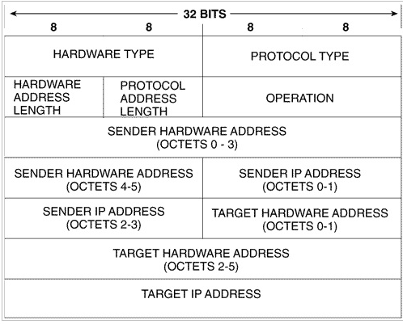
ARP Process
ARP Datagram Structure

Slide 27
ARP Process
Security
In some environments, the ARP protocol may become a source of security weakness. ARP spoofing, also known as ARP poisoning, is a form of attack in which misleading MAC-to-IP associations are introduced into the network by sending falsified ARP messages. If attacke successfully imitates the MAC address of a trusted device, network frames can be redirected away from their legitimate destination
To reduce the risk of such attacks, static ARP entries can be manually configured. By explicitly defining which MAC addresses are permitted on certain network devices, access to the network can be limited to only those systems that have been authorized.

Slide 28
RARP Protocol
In contrast to ARP, the Reverse Address Resolution Protocol (RARP) allows a device that does not initially possess an IP address such as a diskless workstation or a network printer to obtain one. For this mechanism to function, a designated system on the network must be configured to receive and answer RARP requests; this system acts as the RARP server.
The packet structure used by RARP is the same as that employed by ARP. The only difference lies in the value of the operation code field, which is set to 3 for a request and to 4 for a reply.

Slide 29
References
D. E. Comer, Computer Networks and Internets, Pearson.
F. Halsall, Data Communications, Computer Networks and Open Systems, Addison-Wesley.
U. Black, Data Networks, Prentice Hall.
R. Perlman, Interconnections: Bridges, Routers, Switches, and Internetworking Protocols, Addison-Wesley.
IEEE, IEEE 802.1 and 802.3 Standards.

