Slide 1

People’s Democratic Republic of Algeria
National Polytechnic School of Oran – Maurice Audin
Department of Computer Systems Engineering
Active devices
Dr.BOUMEDJOUT AMAL
Email: amal.boumedjout@enp-oran.dz

Slide 2
Course Objective
By the end of the course, students will be able to:
  Understand the role of active network devices in computer networks
  Explain the function of repeaters, bridges, switches, and routers
  Understand how data frames and packets are forwarded
  Identify collision domains and broadcast domains
  Explain how switching and routing decisions are made
  Understand how active devices improve network performance and efficiency
  Analyze the impact of active devices on network scalability

Slide 3
Repeaters
A repeater is a network device designed to restore the integrity of transmitted signals. It regenerates both analog and digital signals that have been degraded by transmission losses caused by attenuation, thereby extending the physical coverage of a network.
Repeaters provide a physical link between two segments belonging to the same logical network.
Their operation is limited to receiving a bit stream on one interface and retransmitting it on another, functioning according to a broadcast mechanism.
A repeater may be used to extend or adapt the transmission medium; however, it does not perform functional interconnection between separate networks. For instance, it can support media adaptation, such as converting a coaxial transmission medium to optical fiber.

Slide 4
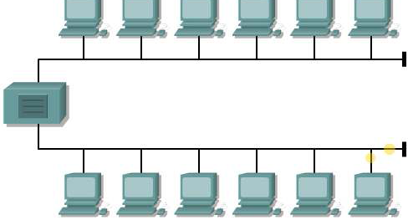
Repeaters
They allow more hosts to be connected to the network. However, each additional host increases the amount of potential traffic. Physical layer devices transmit all data they receive over the medium without filtering. As traffic becomes heavier within a collision domain, the probability of collisions increases, which negatively affects overall network performance.

Slide 5
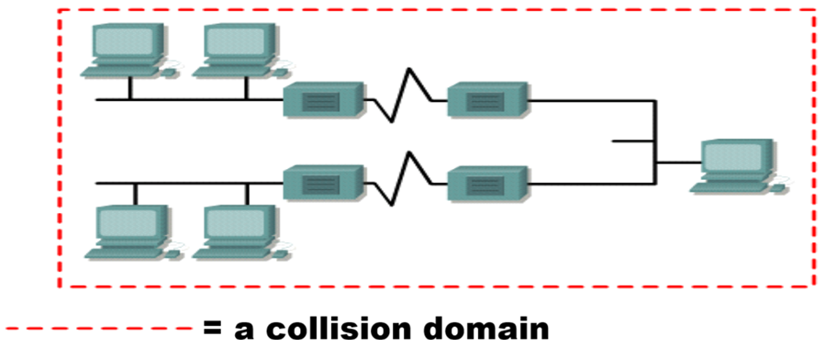
Repeaters
A collision domain is a shared transmission environment in which all connected devices use the same communication medium. Any disturbance or failure occurring in one part of the collision domain is likely to affect the domain as a whole.
The Ethernet four-repeater rule specifies that no more than four repeaters or hubs may be installed between any two network hosts.

Slide 6
Repeaters
The “5-4-3-2-1 rule” defines a set of strict structural constraints that must be observed in shared Ethernet network architectures. These constraints are as follows:
    Five network media segments
    Four repeaters or hubs
    Three segments populated by end devices
    Two interconnection segments without attached hosts
    One single collision domain

Slide 7
Repeaters
Unicast:
A unicast MAC address is used when a data frame is transmitted from one network device directly to a single intended recipient.
Broadcast:
In broadcast communication, the packet is sent using a destination IP address in which all bits of the host portion are set to one (1). This configuration ensures that every device within the local network segment, known as the broadcast domain, receives and processes the packet. To support this operation at the data link layer, the Ethernet frame must contain the corresponding broadcast MAC address. In Ethernet networks, this address is made up of 48 bits all set to one and is represented in hexadecimal notation as FF-FF-FF-FF-FF-FF.
Multicast:
Multicast addressing enables a source device to transmit data to multiple selected devices simultaneously. Devices that join a multicast group are assigned a specific multicast IP address. The range reserved for multicast IP addresses spans from 224.0.0.0 to 239.255.255.255. For proper delivery on a local network, each multicast IP address maps to a dedicated multicast MAC address. This MAC address follows a defined format and begins with the hexadecimal prefix 01-00-5E (for example, 01-00-5E-00-00-0A).

Slide 8
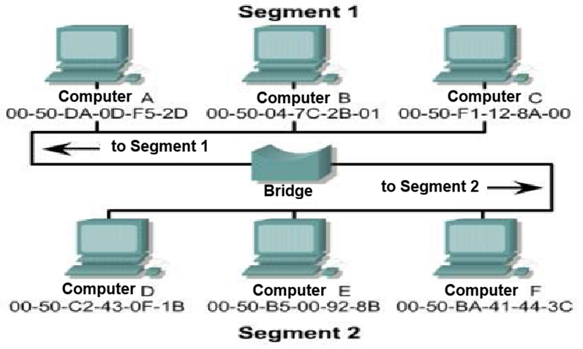
Bridges
In certain circumstances, it may be necessary to partition a large local area network into multiple smaller segments in order to simplify administration and improve manageability.

Slide 9
Bridges
This approach reduces traffic on a given LAN while enabling the expansion of the area that was previously supported by a single LAN.
Bridges and switches can be employed to interconnect different network segments.
Operating at the Data Link layer of the OSI model, bridges and switches manage the flow of data efficiently.
Bridges, in particular, provide compatibility between networks of the same type (such as Ethernet-to-Ethernet or Token Ring-to-Token Ring) as well as between different network types (such as Ethernet-to-Token Ring).
A bridge determines intelligently whether to forward data to the next segment, using MAC addresses to perform Layer 2 routing. Bridges can only link networks that share a uniform addressing scheme.

Slide 10
Bridges
  When the destination device is located on the same segment as the incoming frame, the bridge refrains from forwarding it to other segments. This operation is known as filtering.
  If the destination device resides on a different segment, the bridge forwards the frame to the correct segment.
  In cases where the bridge does not have knowledge of the destination address, it sends the frame to all segments except the one from which it was received. This behavior is referred to as flooding.

Slide 11
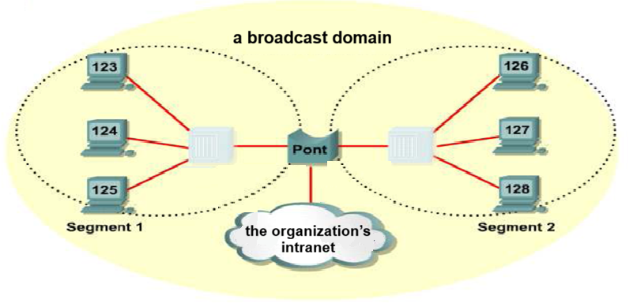
Bridges
A bridge segments a collision domain without impacting the logical or broadcast domains.
In the absence of Layer 3 devices, such as routers, the entire network operates within a single logical broadcast address space.
Consequently, while the bridge increases the number of collision domains, it does not introduce additional broadcast domains.

Slide 12
switches
Switches are commonly regarded as multiport bridging devices.
In a manner similar to bridges, switches analyze the data frames received from networked systems. The extracted information is then used to construct internal forwarding tables, enabling the switch to accurately determine the intended destination of data exchanged within the network.
interface | MAC address
E0 | 0260.8c01.1111
E1 | 0260.ec01.2222
E2 | 0260.ec01.3333
E3 | 0260.8c01.4444

Slide 13
switches
Switches are equipped with a memory structure known as Content Addressable Memory (CAM). This memory enables a switch to efficiently identify the port associated with a specific MAC address.

Slide 14
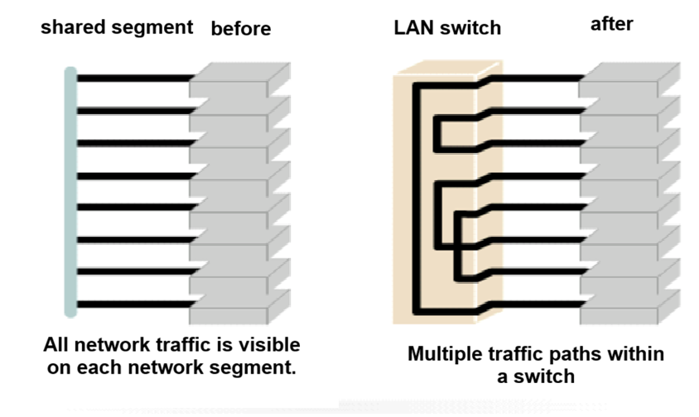
switches
A network switch is a device composed of multiple ports that interconnect different segments of a network. It analyzes the destination of transmitted data and forwards it exclusively through the port linked to the target device or workstation.
Ethernet switches are commonly implemented in network infrastructures because they enhance data transmission efficiency, make optimal use of available bandwidth, and contribute to improved overall network performance.

Slide 15
switches
  Switching is a networking technology designed to reduce congestion in Ethernet LANs by limiting unnecessary traffic and increasing available bandwidth. Switches can easily replace hubs since they operate over the same existing cabling infrastructure.
    This upgrade enhances network performance while requiring only minimal changes to the network setup.
  Most modern switches and network interface cards support full-duplex communication. In full-duplex mode, devices can send and receive data simultaneously, eliminating media contention. As a result, collision domains are removed.
  Enabling full-duplex operation typically leads to a significant increase in effective bandwidth, often close to doubling the data transmission capacity.

Slide 16
switches
A switch is essentially a very fast multiport bridge that can support dozens of ports. Each port operates as an independent collision domain.
For example, in a network with 20 nodes, there will be 20 separate collision domains if each node is connected to its own switch port.
If an uplink port is added, the switch then creates a total of 21 collision domains (one per connected device).
Note: Devices connected through repeaters remain within the same collision domain. In contrast, devices separated by bridges, switches, or even routers belong to different collision domains.

Slide 17
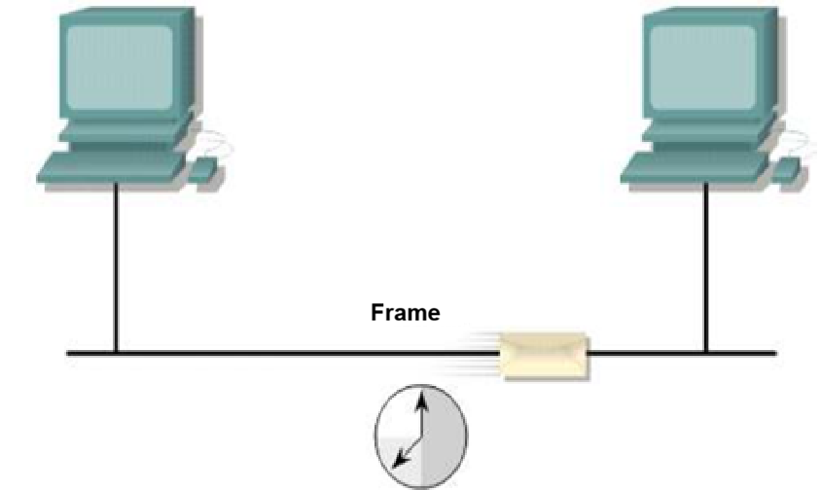
Latency
Latency is the delay between when a data frame is transmitted from a source device and when the initial portion of that frame arrives at the destination.

Slide 18
Latency
Several factors can contribute to these delays:
Media-related delays occur because signals travel at a limited speed through the physical transmission medium.
Circuit-related delays result from electronic components that process the signal as it moves along the network path.
Application-level delays are introduced by software decisions involved in implementing switching mechanisms and network protocols.
Additional delays may depend on the frame’s content and where switching decisions are made. For instance, a device cannot forward a frame until the destination MAC address has been recognized.

Slide 19
Switching Modes
The process of directing a frame to its destination port is governed by considerations of latency and reliability.
Under this mechanism, a switch begins forwarding the frame immediately after detecting the destination MAC address.
This switching method, known as cut-through switching, is recognized for its minimal transmission delay.

Slide 20
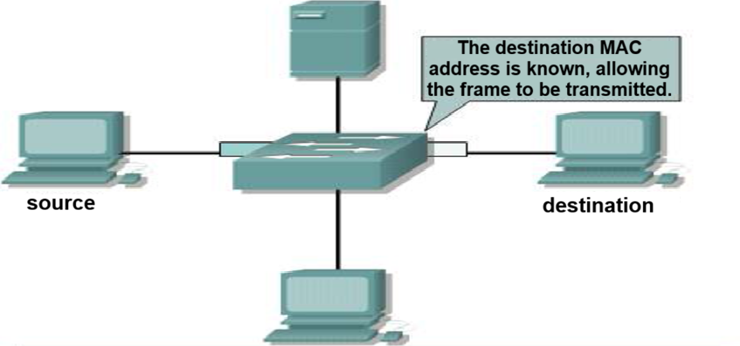
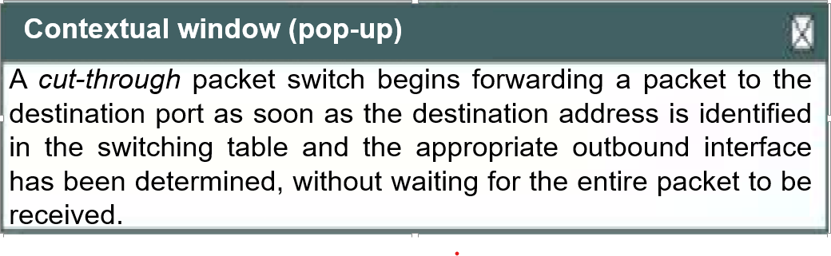
Switching Modes

Slide 21
Switching Modes
Store-and-Forward:
In this operating mode, the switch first receives the complete frame before initiating forwarding to the destination interface. This allows the switch to carry out an integrity check based on the Frame Check Sequence (FCS). Any frame that does not meet the validity criteria is rejected at the switch. Because forwarding occurs only after the frame has been fully stored, this method is known as store-and-forward switching.

Slide 22
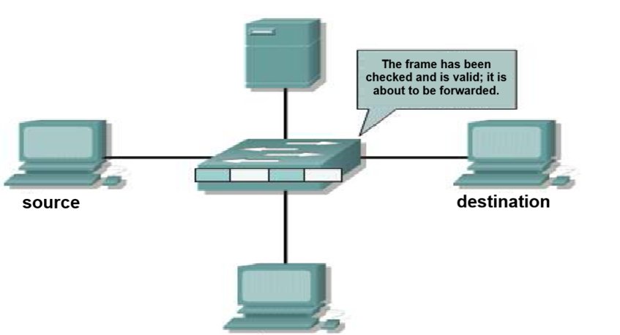
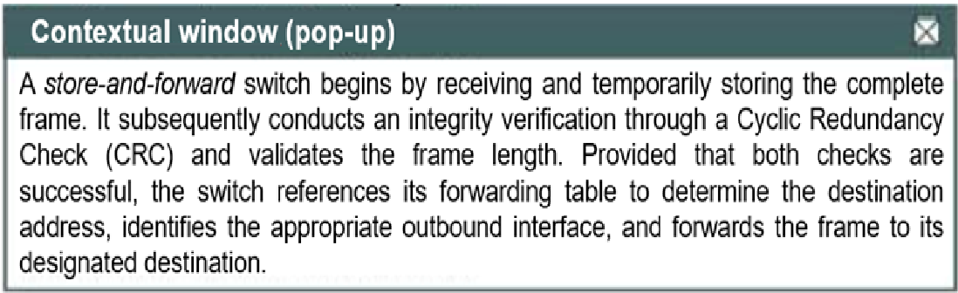
Switching Modes
Store-and-Forward

Slide 23
Switching Modes
Fragment-Free switching is an intermediate packet-forwarding technique that balances efficiency and verification. In this mode, the network device examines only the initial portion of the frame specifically the first 64 bytes before initiating transmission, without waiting for the complete payload or the final error-checking field.
This preliminary inspection ensures the validity of addressing information and the parameters associated with the LLC protocol, thereby enabling accurate data processing and reliable delivery to the intended destination.

Slide 24
Switching Modes
In cut-through switching, both the source and destination ports must operate at identical throughput levels to avoid damaging the transmitted frame, a condition known as symmetric switching.
When port speeds are unequal, the frame is accepted at one rate and delivered at another, which defines asymmetric switching.
Under these circumstances, the store-and-forward approach is necessary to preserve data integrity during transmission.

Slide 25
the switches
Compared with bridges, network switches are engineered to function at markedly higher transmission speeds and to support additional capabilities, such as the implementation of Virtual Local Area Networks (VLANs).
As a result, switches are frequently characterized as devices that incorporate operational features aligned with Layer 3 of the OSI architecture.

Slide 26
Broadcast domain
In order to facilitate communication across all collision domains, networking protocols make use of broadcast and multicast frame transmission mechanisms operating at Layer 2 of the OSI reference model.
Broadcast frames are delivered to every station within the network and are forwarded across all bridges, irrespective of the location of the receiving host. As a result, this behavior undermines the performance and efficiency advantages typically associated with bridge-based network architectures.
When a node needs to communicate with all hosts on the network, it transmits a broadcast frame using the destination MAC address 0xFFFFFFFFFFFF. The network interface card of each host is then required to process this frame and send a response to that address.

Slide 27
Broadcast domain
A broadcast domain is defined as a set of collision domains interconnected through networking devices operating at Layer 2 of the OSI model.
By segmenting a local area network into multiple collision domains, hosts experience improved access to the shared transmission medium. This architectural approach minimizes the probability of frame collisions and allows a more efficient allocation of available bandwidth to each host.
Broadcast frames are propagated by Layer 2 devices, but excessive broadcast traffic can negatively impact the performance of the entire LAN. Consequently, the regulation of broadcast traffic must be performed at Layer 3, as devices functioning at Layers 1 and 2 do not possess the mechanisms required to limit or filter such traffic.
For this reason, broadcast domains are controlled at Layer 3, since routers inherently block the forwarding of broadcast frames.

Slide 28
Broadcast domain
Networking devices operating at Layer 3 perform packet filtering by examining destination IP addresses.
A data packet is transmitted only when its destination resides outside the local broadcast domain and when the router has successfully identified the correct forwarding path.
As a result, a Layer 3 device inherently defines multiple broadcast domains and multiple collision domains.

Slide 29
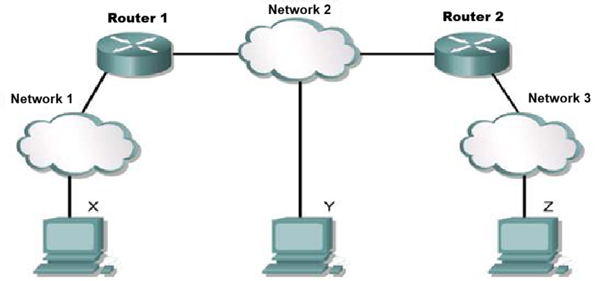
Routers
Routing devices determine the forwarding paths required to support communication between separate networks. In environments where traffic volume is substantial, multiple routers are needed to efficiently process and manage data transmissions.

Slide 30
Routers
Routers provide a wide range of networking functions, including signal regeneration, consolidation of multiple links, transformation of data transmission formats, and control of data flows. In addition, they are able to connect to wide area networks (WANs), thereby linking local area networks that are geographically distant.
No other networking equipment is capable of delivering this type of inter-network connectivity.

Slide 31
References
W. Stallings, Data and Computer Communications, Pearson.
A. S. Tanenbaum and D. Wetherall, Computer Networks, Pearson.
B. A. Forouzan, Data Communications and Networking, McGraw-Hill.
R. Perlman, Interconnections, Addison-Wesley.
IEEE, IEEE 802.3 Ethernet Standard.

