Slide 1

People’s Democratic Republic of Algeria
National Polytechnic School of Oran – Maurice Audin
Department of Computer Systems Engineering
Optical fiber
Dr.BOUMEDJOUT AMAL
Email: amal.boumedjout@enp-oran.dz

Slide 2
Course Objective
By the end of the course, students will be able to:
Understand the role of optical fiber in computer networks
Explain how data is transmitted using light signals
Describe the structure and components of optical fiber cables
Understand the basic principles of light propagation in fiber
Distinguish between single-mode and multimode fiber
Identify the advantages of optical fiber compared to copper media
Understand the use of optical fiber in high-speed networks

Slide 3
Optical Fiber
Before the advent of optical fiber, all network infrastructures were built using copper wires or coaxial cables. Today, an increasing number of organizations are adopting optical fiber, as it offers significant advantages over copper-based media.

Slide 4
Comparison with Other Media
 | Twisted Pair | Coaxial Cable | Optical Fiber
Cost Level | Low cost | Moderate cost | High cost
Bandwidth | Medium | Wide | Very wide
Maximum Length | moderate | hight | hight
Resistance to Interference | Low to medium | Medium to high | Very hight
Ease of Connection | Easy | Variable | Difficult
Ease of Setup | Variable | Variable | Difficult
Reliability | hight | hight | Very hight

Slide 5
Operating Wavelengths f = c / λ
Visible light
Ultraviolet (UV)
Infrared (IR)
λ
800 nm
1300 nm
1550 nm
Waves that are not visible to the human eye are used for data transmission in optical fiber systems. These waves are slightly longer than red light waves and belong to the infrared region, which is also commonly used in television remote controls. The light transmitted through an optical fiber typically uses wavelengths of 850, 1,310, or 1,550 nanometers.

Slide 6
Optical Fiber
in local area networks, data is mainly conveyed as electrical signals. As optical fiber links transmit information using light, electrical signals must be converted into optical signals at one end of the fiber and reconverted into electrical signals at the opposite end. Therefore, a transmitter and a receiver are required.

Slide 7
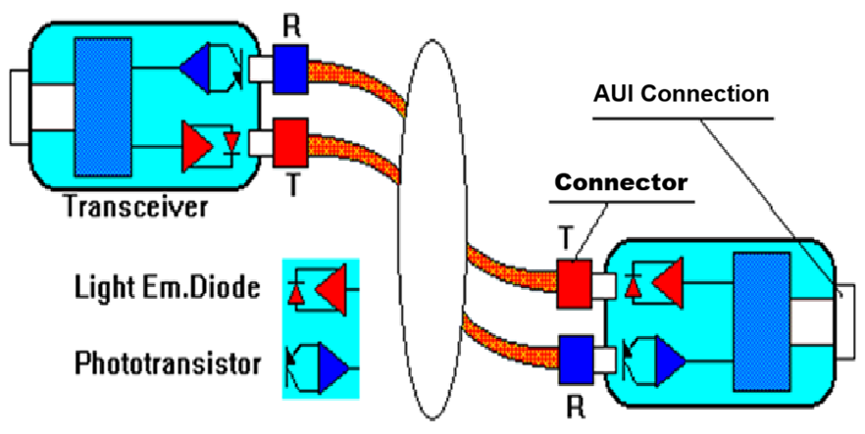
Electrical-to-optical signal conversion using an Ethernet transceiver

Slide 8
Optical Fiber
An optical fiber cable is a networking medium designed to transmit modulated light signals. Even though optical fiber is more expensive, it is unaffected by electromagnetic interference and can support much higher data throughput. Unlike network media based on copper wiring, optical fiber does not transmit electrical signals.

Slide 9
Optical Fiber
The signals representing bits are converted into light beams. Although light is an electromagnetic wave, optical fiber transmission is not considered wireless, because electromagnetic waves are guided within the optical fiber. The term wireless is used only for electromagnetic waves that propagate without guidance from a physical medium.

Slide 10
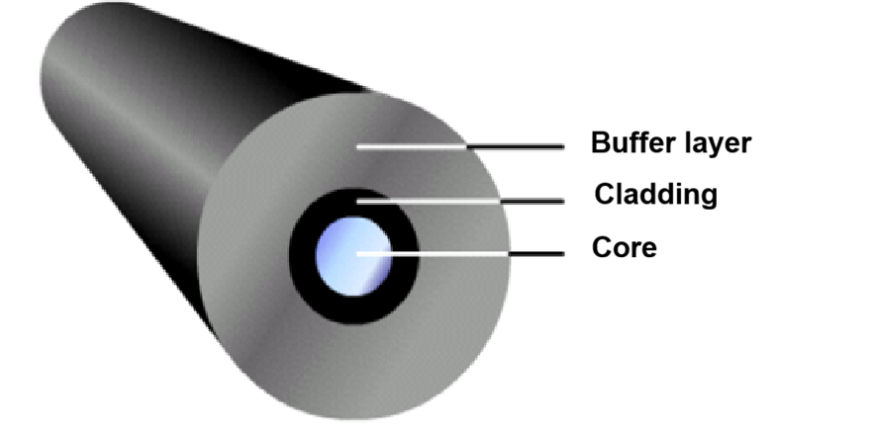
Optical Fiber
Optical fiber is a cylindrical glass structure made of silica that has properties enabling it to guide light through its core. The core must be highly pure to minimize energy loss caused by absorption. Optical fiber cables used in networking typically contain two fibers, each enclosed in a separate protective layer.

Slide 11
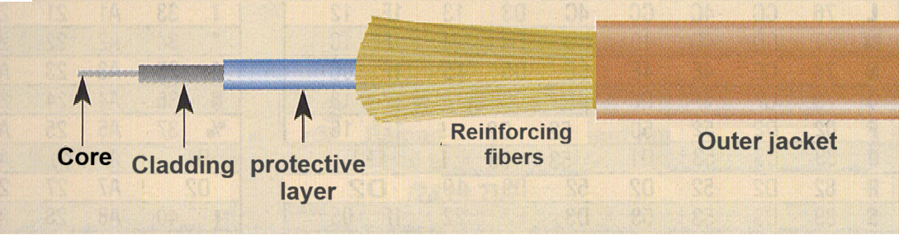
Optical Fiber
A fiber-optic cable is made up of a core, an optical cladding, a protective layer, reinforcing fibers, and an outer jacket, as illustrated in the figure.

Slide 12
Optical Fiber
Core
The core is the physical element that transmits optical signals from a light source to a receiving device. Optical fiber cables are classified according to the diameter of the core. A larger core diameter allows a higher amount of light to be transmitted. The most commonly used core diameters are 50, 62.5, and 100 micrometers (µm).
Cladding
The cladding is a thin layer surrounding the core. It confines the light within the core by refraction, allowing data to propagate along the entire length of the optical fiber.
protective layer
The protective layer is a plastic layer that surrounds the core and the cladding to reinforce the fiber. It absorbs mechanical shocks and provides additional protection against excessive bending. The diameter of this layer typically ranges from 250 to 900 µm.
Reinforcing fibers
Reinforcing fibers protect the fiber core from crushing forces and excessive tensile stress during installation. Commonly used materials include Kevlar®, steel wires, or gel-filled layers.
Outer jacket
The Outer jacket is the external layer of the cable. Most optical fiber cables use an orange Outer jacket, although some types may also be black or yellow.

Slide 13
Optical Fiber
A light ray can enter the fiber core only if its angle is within the numerical aperture of the fiber. After entering the core, the light is limited to a small number of paths, known as modes. When the core diameter is large, the fiber allows several paths and is called a multimode fiber. When the core diameter is small, only one path is possible, and the fiber is called a single-mode fiber.

Slide 14
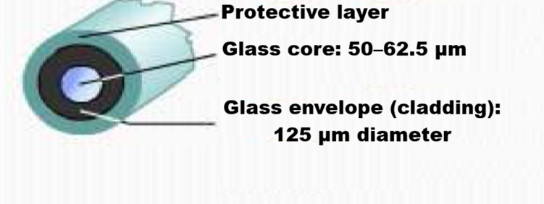
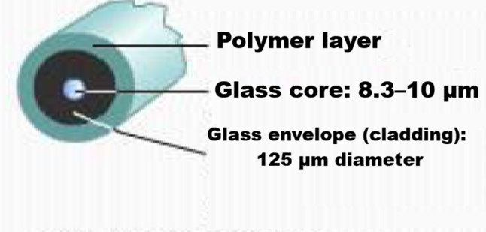
Optical Fiber
Core diameter larger than that of single-mode fiber (50 or 62.5 micrometers or more)
Allows greater dispersion, which results in increased signal attenuation
Designed for long-distance transmission, but over shorter distances than single-mode fiber (approximately up to 2 km)
Uses LED light sources, commonly in local area networks or over links of a few hundred meters within a campus network
Small core diameter
Reduced signal dispersion
Designed for long-distance transmission (up to about 3 km)
Uses laser light sources, commonly applied in campus backbone networks over distances of several kilometers

Slide 15
Optical Fiber
A light-emitting diode (LED) that generates infrared light at wavelengths of 850 or 1,310 nanometers, used with multimode fiber in local area networks. Optical lenses are used to guide the infrared light into the fiber end.
A laser source (Light Amplification by Stimulated Emission of Radiation) that produces a narrow, high-intensity infrared beam at wavelengths of 1,310 or 1,550 nanometers. It is used with single-mode fiber for long-distance transmission in wide area networks or campus backbone links. This technique requires precautions to avoid eye damage.

Slide 16
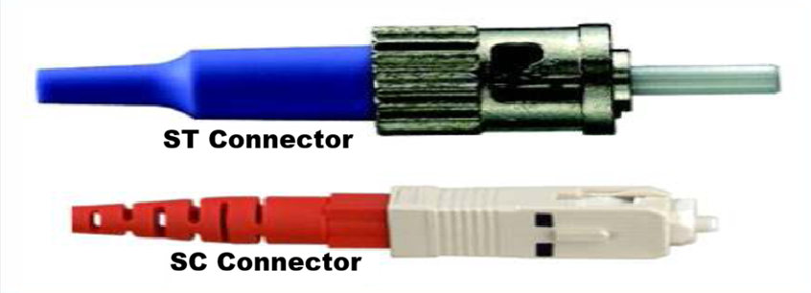
Fiber-optic connectors and adapters
Connectors are attached to the ends of optical fibers so that they can be connected to the transmitter and receiver ports.
The most widely used connectors are SC (Subscriber Connector) for multimode fiber and ST (Straight Tip) connectors for single-mode fiber.

Slide 17
Optical Fiber
These light rays are comparable to laser beams. In a vacuum, light propagates in a straight path at a constant speed of 300,000 kilometers per second. In contrast, its speed is lower in materials such as air, water, and ice. When a light ray, called the incident ray, passes from one material into another, a portion of the light energy is reflected. This effect explains why an image appears on a glass surface. The reflected portion of the light is known as the reflected ray.

Slide 18
Refractive index of a medium
The absolute refractive index n1​ of a medium is the ratio between the speed of light in a vacuum and the speed of light within that medium.
c
n
=
1
c
1
Speed of light: C=300,000 km/s

Slide 19
Propagation speed
Propagation speed of light in a vacuum:
C=300,000 km/s (velocity)
The propagation speed of light in a medium is:
propagation speed =C/n
where (n represents the refractive index).
Typical refractive indices:
1.0 for vacuum
1.003 for air
1.3 for water
1.5 for glass
2.0 for diamond

Slide 20
Reflection
First law of reflection (Descartes’ law)
Reflection is the process by which light is sent back by a surface.
The reflected ray is contained in the plane of incidence.
The reflection angle i′ is equal to the incidence angle i.
i
i'
Incident ray
Reflected ray
Normal
n₁
n₂

Slide 21
Refraction
Second law of refraction (Descartes’ law)
Refraction is the deflection of light rays as they pass from one transparent medium to another.
The refracted ray lies in the plane of incidence.
The angle of refraction follows the law:
n₁​ sin i = n₂ ​sin r
i
Incident ray
N
n₁
n₂
r
Refracted ray

Slide 22
Reflection and Refraction
i
Incident ray
α
N
Reflected ray
n₁
n₁ > n₂
n₂
Refracted ray
i = α = Critical angle of refraction
i > α (Mirror effect)

Slide 23
Principle of light guidance in an optical fiber
Refracted ray
n₁
Guided ray
N
n₂
There exists a critical injection angle

Slide 24
Light injection into the fiber
Acceptance cone
n₁
N
N
n₂
Numerical Aperture (NA)

Slide 25
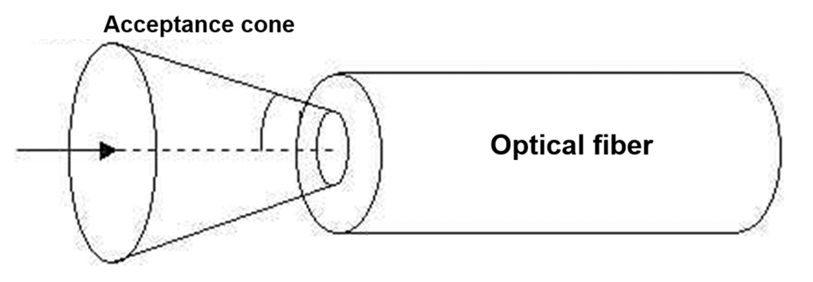
Guiding conditions
There are two guiding conditions:
n1​>n2​
i < θ ⟹ total internal reflections occur along the entire optical fiber

Slide 26
Ethernet Cable Color-Coding Standard
The two types of optical fiber used
Multimode fiber
Single-mode fiber
10 µm < Core radius < 100 µm
Bandwidth limited to 1 GHz
Step-index and graded-index fibers
Very small core radius
Bandwidth > 1GHz
Step-index fibers

Slide 27
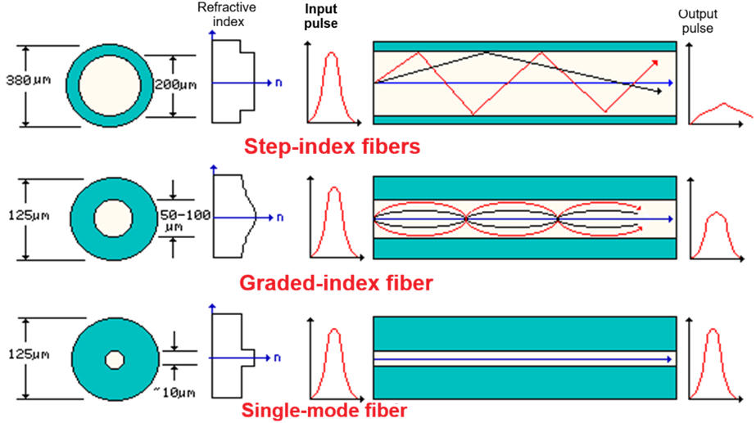

Slide 28
Step-index multimode fiber
r
n₂
n
n₁
They are composed of :
A core with refractive index n₁
A cladding with refractive index n₂.

Slide 29
Graded-index multimode fiber
r
n
The core refractive index varies according to a parabolic law as a function of the radius r.

Slide 30
Graded-index multimode fiber
Light propagation in graded-index multimode fiber
n₁
n₂
τ
τ’
Multiple propagation modes
t
t
Attenuation
Reduced pulse spreading
Emitted pulse

Slide 31
Single-mode fiber
r
n₂
n
n₁
They are composed of :
A core with refractive index n₁
A cladding with refractive index n₂.
The core diameter is very small.

Slide 32
Single-mode fiber
Light propagation in single-mode fiber
n₁
n₂
τ
τ
Single propagation mode
t
t
Emitted pulse
Low attenuation
Low dispersion

Slide 33
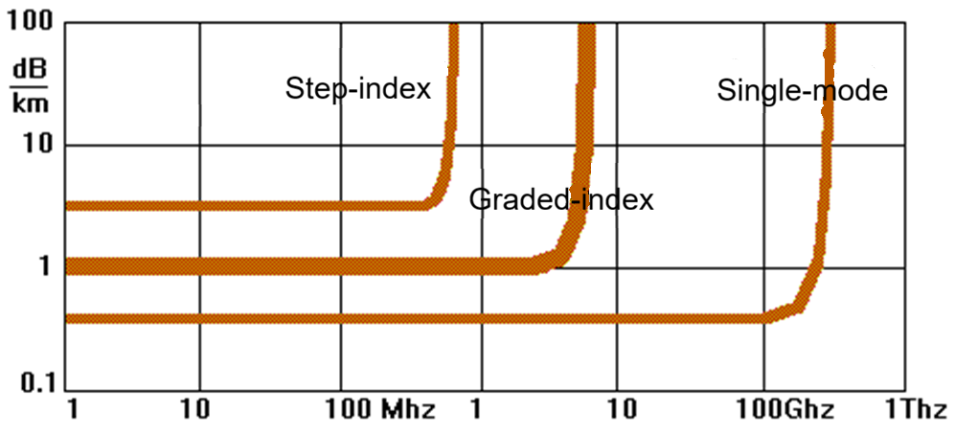
Summary
Signal attenuation does not depend on frequency
(the bandwidth is limited solely by optical dispersion).

Slide 34
Summary
Typical bandwidth values for a 1-km optical fiber are:
Step-index multimode
Graded-index multimode
Single-mode
100 MHz
a few GHz
> 10 GHz

Slide 35
Optical fiber
Poor installation conditions are a common cause of excessive attenuation in optical fiber cables. When the fiber is overstretched or bent too tightly, microscopic defects can form and scatter the transmitted light. Excessive curvature may also alter the angle at which light rays strike the core–cladding interface. If this angle drops below the critical angle required for total internal reflection, some of the light is lost because it refracts into the cladding rather than being guided along the fiber.

Slide 36
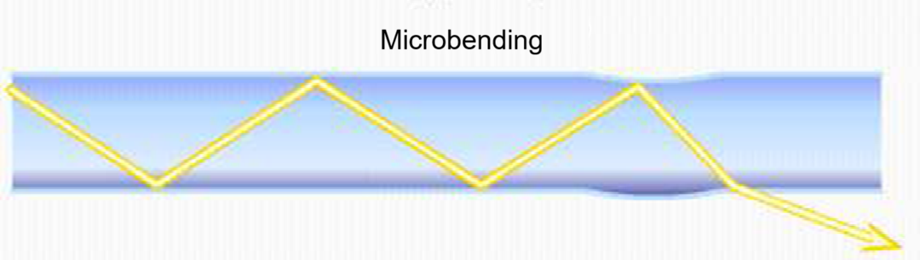
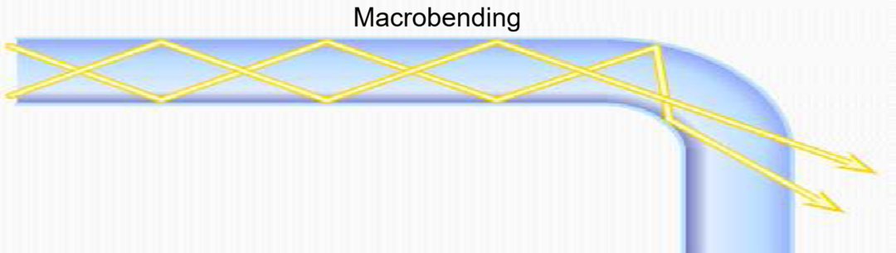
Optical fiber
To prevent excessive bending, the optical fiber is commonly installed in a rigid tube that is less flexible than the fiber. This tube protects the fiber from stretching during installation and ensures that the bend radius remains within acceptable limits.

Slide 37
References
G. Keiser, Optical Fiber Communications, McGraw-Hill.
J. M. Senior and M. Y. Jamro, Optical Fiber Communications: Principles and Practice, Pearson.
B. A. Forouzan, Data Communications and Networking, McGraw-Hill.
W. Stallings, Data and Computer Communications, Pearson.
Cisco Networking Academy, Introduction to Networks.

