Slide 1

People’s Democratic Republic of Algeria
National Polytechnic School of Oran – Maurice Audin
Department of Computer Systems Engineering
Transmission media
Dr.BOUMEDJOUT AMAL
Email: amal.boumedjout@enp-oran.dz

Slide 2
Course Objective
Understand how data is physically transmitted in computer networks
Identify the main types of transmission media used in networking
Explain how signals travel through different physical media
Describe the role of cables, connectors, and network interfaces
Understand basic signal issues such as interference and attenuation
Distinguish between different types of copper cabling (UTP, STP, coaxial)
Recognize common Ethernet cabling standards and categories
Explain the importance of the physical layer in network communication

Slide 3
Type of physical medium
The physical layer is responsible for the network medium and the way signals are transmitted. A number of standards organizations have contributed to defining the physical, electrical, and mechanical characteristics of transmission media used for data communications. These standards ensure that cables and connectors perform reliably and are compatible with various data link layer implementations.
With regard to copper media, standards typically define:
the nature of the copper cabling employed.
the transmission capacity of the link.
the connector types and interfaces.
the wiring arrangements, including pinouts and color conventions.
the maximum supported length of the medium.

Slide 4
Type of physical medium
The most common medium used for data communication is copper cabling. It is used to transmit data and control bits between network devices. This cabling usually consists of several separate copper wires. Each wire forms a dedicated circuit for a specific signaling purpose.
Other types of copper cabling, known as coaxial cables, consist of a single conductor running through the center of the cable, which is surrounded by a protective shield and electrically insulated.
The selection of a copper medium is determined by the physical layer standard required to connect the data link layers of two or more network devices.

Slide 5
Coaxial cable
A coaxial cable consists of two conductive components arranged in a cylindrical configuration. The inner component is a copper conductor surrounded by a flexible insulating layer. Around this insulation, a metallic braid or foil forms the outer conductor, which provides protection for the inner conductor. This shielding layer reduces interference from external sources. The entire assembly is covered by an external protective jacket.

Slide 6
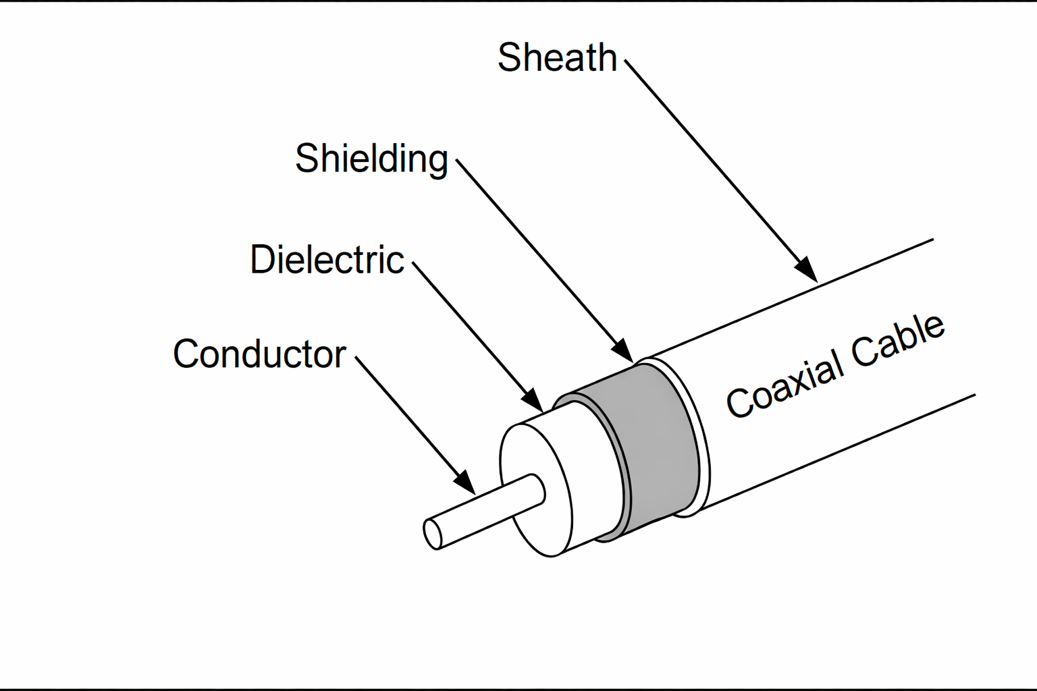
Coaxial cable
In store-and-forward mode, a switch first accepts the complete frame and performs an integrity check by examining the Frame Check Sequence (FCS). Only after this verification does it forward the frame to the output port corresponding to the destination host.
This approach allows network devices to transmit and receive data at the full capacity of the transmission medium, without having to wait for channel availability and without the risk of frame loss due to collisions or the overhead associated with collision handling.

Slide 7
Coaxial cable
A coaxial cable offers several advantages for local area networks. It enables data transmission over greater distances between network nodes than both shielded and unshielded twisted-pair cables, while requiring a smaller number of repeaters. Repeaters are devices that regenerate network signals, allowing them to travel over longer distances. Coaxial cable is also more cost-effective than fiber-optic cable. Furthermore, it is based on a well-established technology that has been widely used for many years in various data communication systems.

Slide 8
Twisted-pair cable
Unshielded twisted-pair (UTP) cabling, as used in Ethernet local area networks, consists of four pairs of color-coded wires that are twisted together and protected by a flexible plastic cover. As illustrated in the figure, the color codes identify each individual pair and the wires within each pair, which facilitates cable connection.
The twisting of the wires serves to eliminate unwanted signals.

Slide 9
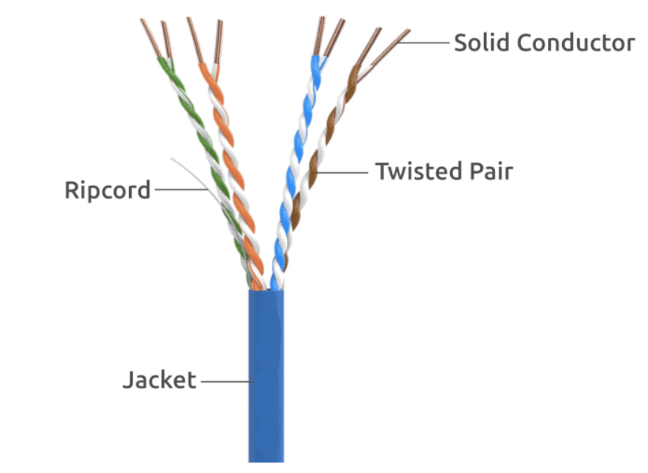
Twisted-pair cable
This is a picture of a UTP Cable sold by Syston Cable Technology

Slide 10
Twisted-pair cable
This cancellation effect also helps to prevent interference from internal sources known as crosstalk.
Crosstalk refers to interference caused by the magnetic field surrounding adjacent pairs of wires within the cable.

Slide 11
Twisted-pair cable
In addition, each twisted pair in the cable has its own twist rate per meter, which helps limit interference between the wire pairs

Slide 12
Twisted-pair cable
UTP cabling, which is widely used in professional, educational, and residential settings, it complies with standards jointly defined by the TIA (Telecommunications Industry Association) and the EIA (Electronics Industries Alliance), notably the TIA/EIA-568A and 568B standards.

Slide 13
Twisted-pair cable
It most commonly used in LAN cabling environments and defines commercial cabling for local area network installations. It specifies elements such as:
cable types.
cable lengths.
Connectors.
cable termination.
able testing methods.

Slide 14
Twisted-pair cable
For example, Category 5 (Cat5) cable is typically used in Fast Ethernet 100BASE-TX installations. Other categories include enhanced Category 5 (Cat5e) cable and Category 6 (Cat6).
Cables of higher categories are engineered to support higher data transfer rates.

Slide 15
Twisted-pair cable
Types of UTP Cables
UTP cabling with RJ-45 connectors is a common copper medium used to connect network devices, such as computers, to intermediate devices like routers and network switches.
Different situations may require UTP cables that follow different wiring standards. This means that the individual wires in the cable are connected in different orders to the pin sets of the RJ-45 connectors.
The following are the main types of cables based on specific wiring arrangements:
Ethernet straight-through
Ethernet crossover
Rollover

Slide 16
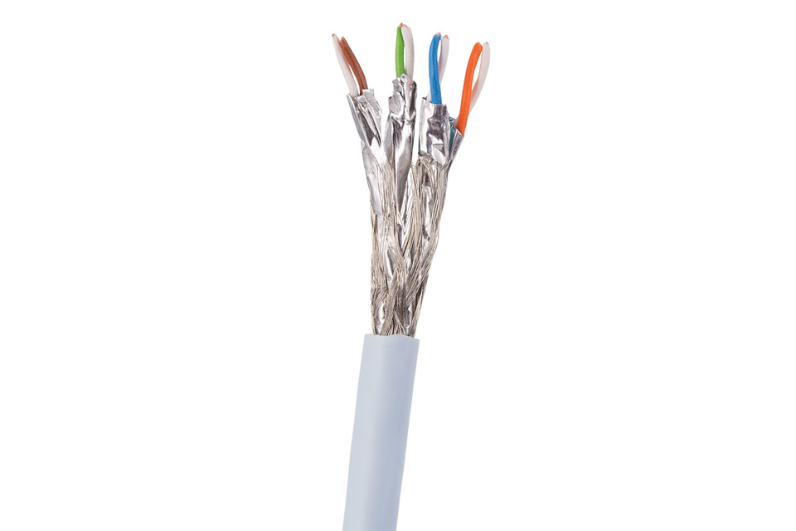
Twisted-pair cable
Another type of cable used in networks is shielded twisted pair (STP). As shown in the illustration, STP uses twisted wire pairs that are wrapped in a braided layer or a thin metal foil.
STP cable protects the entire bundle of wires inside the cable as well as each individual wire pair. It provides better protection against interference than UTP cabling, but it is generally more expensive.
SUPRA CAT8 S-STP network cable (stranded AWG 26/7, CU, LSZH)

Slide 17
Twisted-pair cable
Shielded twisted pair cable has many of the same strengths and limitations as unshielded twisted pair cable. It offers better protection against external interference, but it is more costly and more complex to install than unshielded twisted pair cable.

Slide 18
Twisted-pair cable
A new type of hybrid cable combines an unshielded twisted pair with a shielded twisted pair. The shielded twisted pair is covered with a metallic foil that acts as a shield.

Slide 19
Network outlet
Label holder
Paires N°
1
2
4
3
Contacts
1
2
3
4
5
6
7
8

Slide 20
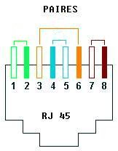
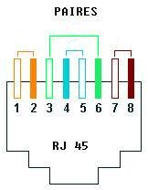
Ethernet Cable Color-Coding Standard
When an RJ-45 connector is inserted into an RJ-45 socket, the network relies on pins 1 and 2 from one pair and pins 3 and 6 from a different pair, thereby avoiding conflicts. This configuration is used in both the 568A and 568B standards.

Slide 21
Ethernet Cable Color-Coding Standard
EIA/TIA-568A
1 | T3 | White - Green
2 | R3 | Green
3 | T2 | White - Orange
4 | R1 | Blue
5 | T1 | White - Blue
6 | R2 | Orange
7 | T4 | White - Brown
8 | R4 | Brown
EIA/TIA-568B
1 | T2 | White-Orange
2 | R2 | Orange
3 | T3 | White - Green
4 | R1 | Blue
5 | T1 | White - Blue
6 | R3 | Green
7 | T4 | White - Brown
8 | R4 | Brown

Slide 22

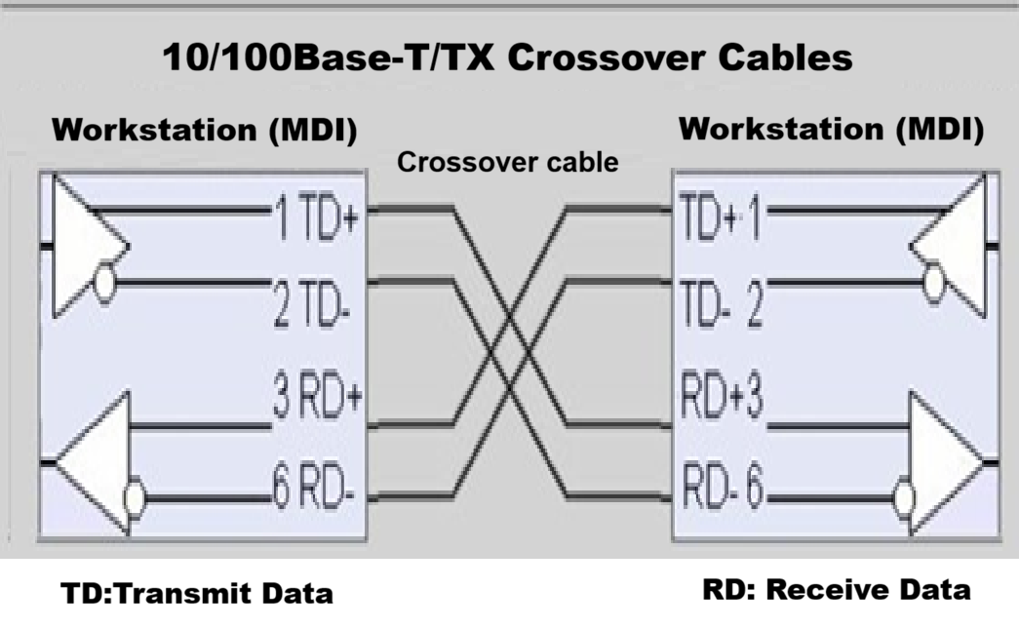
Ethernet Cable Color-Coding Standard
Crossover cable

Slide 23


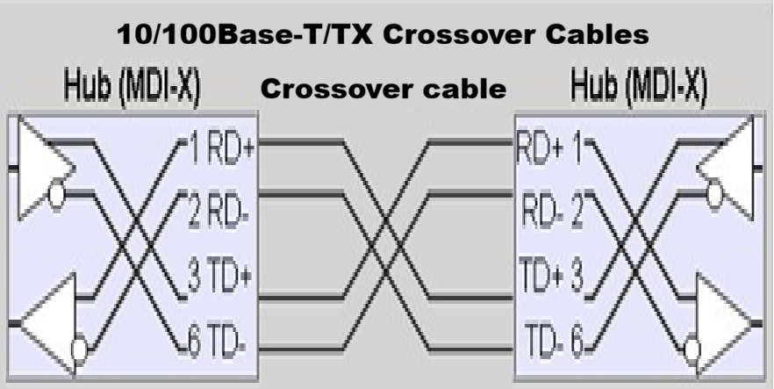
Ethernet Cable Color-Coding Standard
Crossover cable
TD: Transmit Data RD: Receive Data

Slide 24
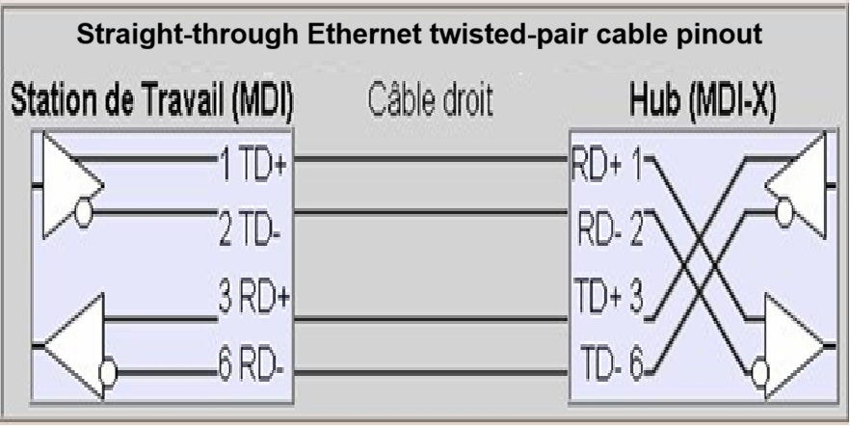
Ethernet Cable Color-Coding Standard
Straight-through cable

Slide 25
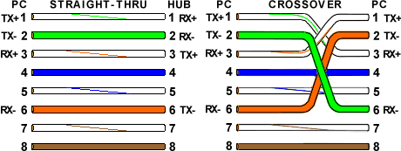
Ethernet Cable Color-Coding Standard

Slide 26
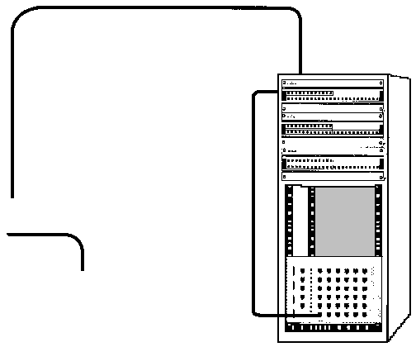
Ethernet Cable Color-Coding Standard
Câblage horizontal
Modular patch panel
Patch
cable
Network outlet
Patch
cable
Access point
Work area
Active equipment

Slide 27
References
A. S. Tanenbaum and D. Wetherall, Computer Networks, Pearson.
B. A. Forouzan, Data Communications and Networking, McGraw-Hill.
W. Stallings, Data and Computer Communications, Pearson.
Cisco Networking Academy, Introduction to Networks.
IEEE, IEEE 802.3 Ethernet Standard.

